Slide 1
Note for Division Staff: Tailor your presentation
This presentation is a comprehensive set of slides that you can customize and use to educate Clearinghouse stakeholders. This may include CDL drivers, their employers (including motor carriers), consortia/third-party administrators (C/TPAs), medical review officers (MROs), and substance abuse professionals (SAPs).
Look at the section titles, then select the slides that will be most relevant to your audience.
Update the Agenda slide to reflect only the topics you will cover.
Tailor the slide notes as needed.
Delete this slide and text shown in red (see title slide and “Contact Us” on final slide) before presenting to your audience.

Slide 2
[Event Name] [Audience]
[Date]

Slide 3
Agenda
1
OVERVIEW OF THE CLEARINGHOUSE
4
VIOLATIONS AND RETURN-TO-DUTY
About the Congressional mandate and what it means
Which violations are reported to the Clearinghouse, and the consequences and next steps for drivers who incur them
2
5
REGISTRATION
COMMON ISSUES AND FAQs
Creating a Clearinghouse account
How to resolve common issues users are experiencing, and responses to frequently asked questions
3
QUERIES AND CONSENT REQUESTS
6
NEXT STEPS
Query and consent requirements in the Clearinghouse
Learn how you can register and get technical support

Slide 4
Overview of the Clearinghouse
Notes:
Let’s begin with an explanation of what the Clearinghouse is.

Slide 5
The Clearinghouse First Final Rule
Mandated by Congress (MAP-21, Section 32402)
Published December 5, 2016
Established requirements for the Clearinghouse
Implemented on January 6, 2020
Learn more and access the Clearinghouse first final rule at:
www.fmcsa.dot.gov/regulations/commercial-drivers-license-drug-and-alcohol-clearinghouse
Notes:
We will discuss the Clearinghouse Second Rule, which has an implementation date of November 8, 2024, a little later in this presentation.

Slide 6
Who is required to use the Clearinghouse?
Drivers who hold commercial driver’s licenses (CDLs) or commercial learner’s
permits (CLPs)
Employers of CDL drivers who operate commercial motor vehicles (CMVs)
Consortia/Third-Party Administrations (C/TPAs)
Medical Review Officers (MROs)
Substance Abuse Professionals (SAPs)
State Drivers Licensing Agencies (SDLAs)

Slide 7
The FMCSA Commercial Driver’s License Drug and Alcohol Clearinghouse
Driver consent
Record
Retain
Query
Employers and medical review officers report violation information to the Clearinghouse (positive tests, refusals to test, actual knowledge)
Secure database retains the violation and CDL/CLP number
Includes driver’s status in return-to-duty (RTD) process
Employers and C/TPAs query the Clearinghouse for driver status and any violation information, with driver consent
FMCSA uses data for enforcement purposes
State enforcement agencies can access current and previous driver eligibility statuses (i.e., Prohibited/Not Prohibited)
Drivers can access only their own information
Notes:
The Clearinghouse will associate a violation with a driver’s CDL information. This will be recorded even if the driver has not registered for the Clearinghouse.

Slide 8
Increasing safety on our Nation’s roadways
Real-time access to reported violation information for select registered users
Easier for employers to meet pre-employment investigation and reporting obligations
Safer Roadways
More difficult for drivers to conceal drug and alcohol violations from employers
More insight into employer compliance with drug and alcohol testing rules

Slide 9
Who is covered by the Clearinghouse rule?
All CDL drivers who operate CMVs on public roads and their employers and service agents. This includes, but is not limited to:
Interstate and intrastate motor carriers, including passenger carriers
School bus drivers
Construction equipment operators
Limousine drivers
Municipal vehicle drivers (e.g., waste management vehicles)
Federal and other organizations that employ drivers subject to FMCSA drug and alcohol testing regulations (e.g., Department of Defense, municipalities, school districts)
Government entities are not required to obtain a USDOT Number under 49 CFR part 390, however they are subject to the Controlled Substances and Alcohol Use and Testing regulations in 49 CFR part 382
Learn more about the specific actions each user can take at:
https://clearinghouse.fmcsa.dot.gov/Resource/Index/User-Roles
Notes:
Which drivers are covered by the Clearinghouse?
CDL drivers = Any driver who holds a CDL (CDL driver) and meets the requirements of the CDL standards (49 CFR Part 383), and the FMCSA Drug and Alcohol Testing Program (Part 382). References to CDL drivers also includes CLP drivers.
For the purposes of this presentation, we use the term “Employers.” Most employers are motor carriers or owner-operators, but the term “employers” encompasses anyone who employs someone with a CDL or CLP.
We also use the term “consortia/third-party administrators” or “C/TPAs” to refer to organizations that employers designate to manage or conduct their drug and alcohol compliance programs. You may also hear these agencies referred to as “service agents” in official rulemaking.

Slide 10
Driver Requirements
Register
Consent
Designate
Be sure to add/verify your CDL
Needed to view Violation History, respond to query consent requests, and designate a SAP
Respond to consent requests for full queries from current and potential employers
Note: All pre-employment queries are full queries
This includes positive tests, test refusals, and actual knowledge
Designate a SAP, if needed, to record RTD information
Failure to provide consent to a request for a full query will result in the driver being prohibited from performing safety-sensitive functions (including operating a CMV) for that employer, in accordance with § 382.703(c).
Notes:
Here is an overview of the actions that drivers are responsible for completing in the Clearinghouse.
Drivers only need to register for the Clearinghouse to view their own violation history and respond to query consent requests. If applicable, a driver also needs to be registered to designate a substance abuse professional.
During registration you’ll add and verify your CDL information. This step is required to view your violation history and respond to query consent requests from an employer or C/TPA.
Another benefit of registering in the Clearinghouse is that drivers will be able to update and designate their preferred method of contact with the Clearinghouse.
Drivers must also respond to an electronic consent request in the Clearinghouse for a full query from a current or potential employer. This includes all pre-employment queries.
Failure to provide consent to such a request will result in the driver being prohibited from performing safety-sensitive functions (including operating a CMV) for that employer, in accordance with 49 CFR 382.703(c).
This means that if you apply for a new job as a CDL driver, you will receive a consent request for a full query, and you will need to respond to that consent request in order to be hired to operate a CMV.
If you do not plan on changing employers, you may still need to register for the Clearinghouse if your employer chooses to conduct a full query to access your Clearinghouse record.

Slide 11
Owner-Operator Requirements
Register
Query
Designate
Register as an employer, indicate you are an owner-operator
Link to your FMCSA Portal account (optional)
Add/verify your CDL (optional)
Check if a driver is prohibited from operating a CMV
Pre-employment queries on any new drivers
Annual queries on all drivers, including yourself
Designate a C/TPA (required)
C/TPA must report violations and RTD information
Owner-operators may designate C/TPA to conduct queries, or conduct their own
Notes:
Now let’s talk about owner-operator requirements.
If you are an owner-operator, you’ll register as an employer and indicate that you are an owner-operator. During registration you will link your Clearinghouse with your Portal account, if applicable.
You can also add and verify your CDL number, if applicable.
Owner-operators must conduct pre-employment and annual queries to check if a driver is prohibited from operating a CMV.
Driver consent is required before a query can be conducted.
Owner-operators MUST designate at least one consortium/third party administrator to report violations and RTD information. The C/TPA may be designated to conduct queries.
A C/TPA may be designated during registration, or after you have completed your registration, BUT you cannot complete any actions in the Clearinghouse until you have designated at least one C/TPA.

Slide 12
Employer Requirements
Register
Record
Query
Designate
Link to your FMCSA Portal account (optional)
Report CDL driver drug and alcohol program violations
Positive alcohol tests, test refusals, actual knowledge
Check if driver is prohibited from operating a CMV
Pre-employment and annual
Designate a C/TPA (optional)
C/TPA may conduct queries, report violations and RTD information on your behalf
Notes:
Next, we’ll talk about what actions employers are responsible for completing in the Clearinghouse.
Employers will register and link their Clearinghouse with their Portal account, if applicable.
They’ll also report CDL driver drug and alcohol program violations including positive tests, test refusals, and actual knowledge.
Employers must also conduct pre-employment and annual queries to check if a driver is prohibited from operating a CMV.
Driver consent is required before a query can be conducted.
Employers can also designate a consortium/third party administrator, if desired, and authorize the actions the C/TPA will complete on their behalf.
A C/TPA may be designated during registration, or after the employer has completed registration.

Slide 13
MRO and SAP Requirements
Register
Report
MRO
Self-certify you meet all MRO qualifications per § 40.121
Positive, adulterated, substituted drug tests or test refusals
Self-certify you meet all SAP qualifications per § 40.281
Driver must designate you in the Clearinghouse
Enter RTD information: date of initial SAP assessment, and date driver determined eligible for RTD testing
SAP
Notes:
Here is an overview of the actions that MROs and SAPs are responsible for completing in the Clearinghouse.
MROs must register and self-certify that they meet all MRO qualifications per §40.121
They also report positive, adulterated, substituted drug tests or test refusals per §40.191
SAPS must register and self-certify that they meet all SAP qualifications per §40.281
SAPs will also enter certain information about a driver’s return-to-duty process including the date of the initial SAP assessment and the date the SAP determines the driver is eligible for RTD testing
Before you can enter RTD information about a driver, you will need to approve the driver’s request in the Clearinghouse to become their designated SAP

Slide 14
Registration
Notes:
Let’s now take a closer look at the requirements for conducting queries and obtaining driver consent.

Slide 15
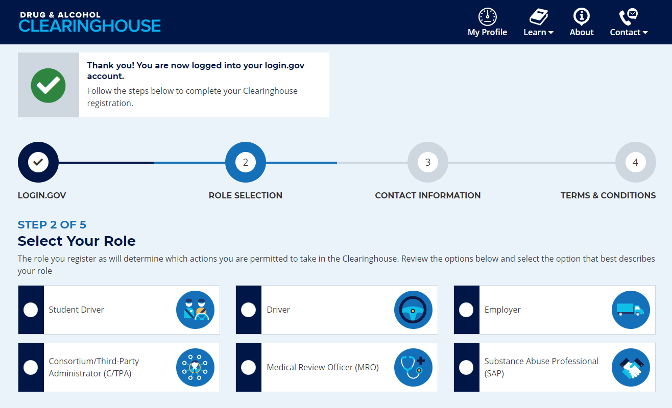
Registering for the Clearinghouse
Must have a Login.gov account to register for the Clearinghouse
When selecting a method for second factor authentication, do not select “backup codes”
After you have logged in to your Login.gov account, select your user role
Notes:
Registration has been open on the Clearinghouse website since October 1, 2019.
Instructional job aids are available to help walk through registration for every user type.
We have had some frequently asked questions about the registration process, so we do have some tips for you to follow.
We recommend that users do not select the “backup codes” option as an authentication method, as they can only be used a limited number of times. This is meant as a fallback, in case none of the other methods (phone call, text message) work for you. These are also considered the least secure option by login.gov.
The back up code creates 10 codes that can only be used one time. If you have used 9 of these codes, you should generate a new set before using the last code.
If a user chooses the backup codes option but is unable to provide a backup code during the log in process, the user must delete the login.gov account, which requires a 24 hour waiting period, before creating a new login.gov account.
If you do need to delete your login.gov account and experience any difficulty logging into the Clearinghouse with your new login.gov account, send an email to clearinghouse@dot.gov for assistance.

Slide 16
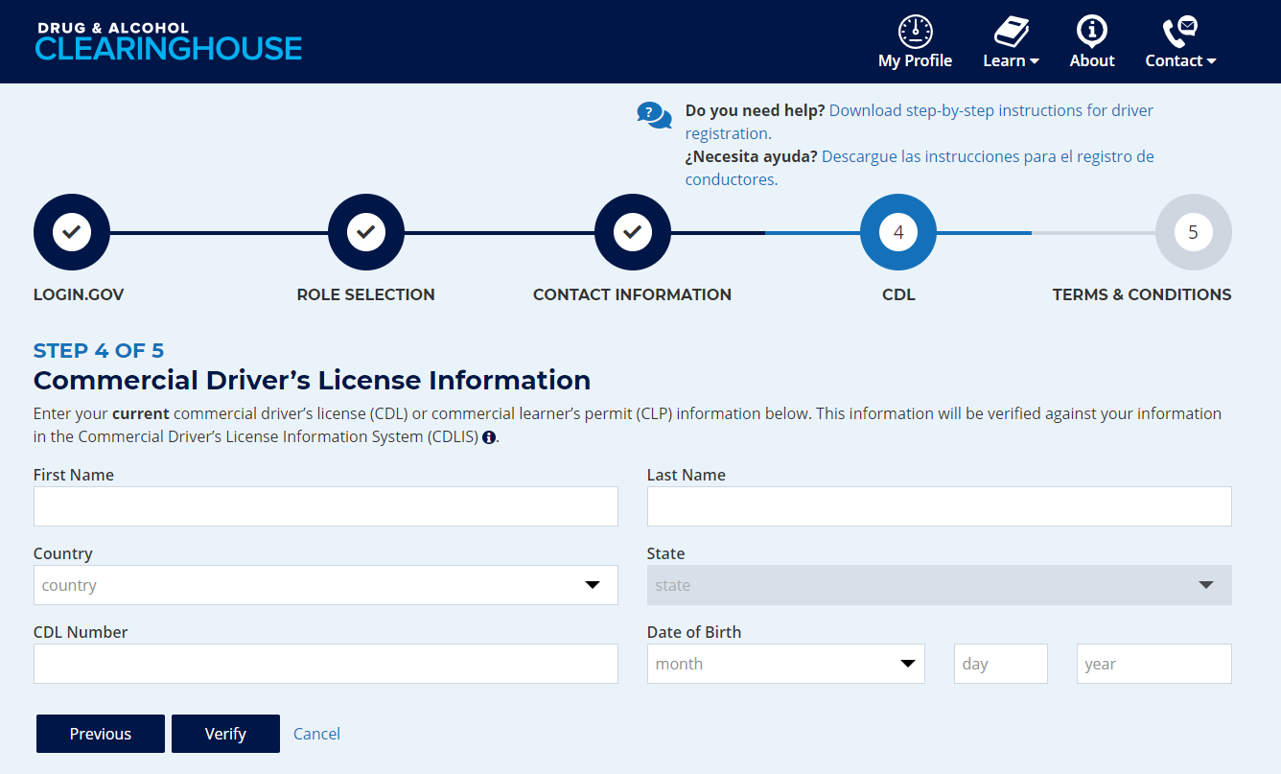
Registering for the Clearinghouse – Drivers
Enter and validate your current commercial driver’s license (CDL) or commercial learner’s permit (CLP) information
Note: This is required to view your Clearinghouse record and respond to query consent requests
Include any leading zeroes
Try entering with or without special characters (spaces, hyphens), as requirements vary by State

Slide 17
Registering for the Clearinghouse – Student Drivers
Only select Student Driver if you are not participating in an employer-based training program
If participating an employer-based program, select “Driver”
You will be required to designate a C/TPA
Enter and validate your current commercial driver’s license (CDL) or commercial learner’s permit (CLP) information

Slide 18
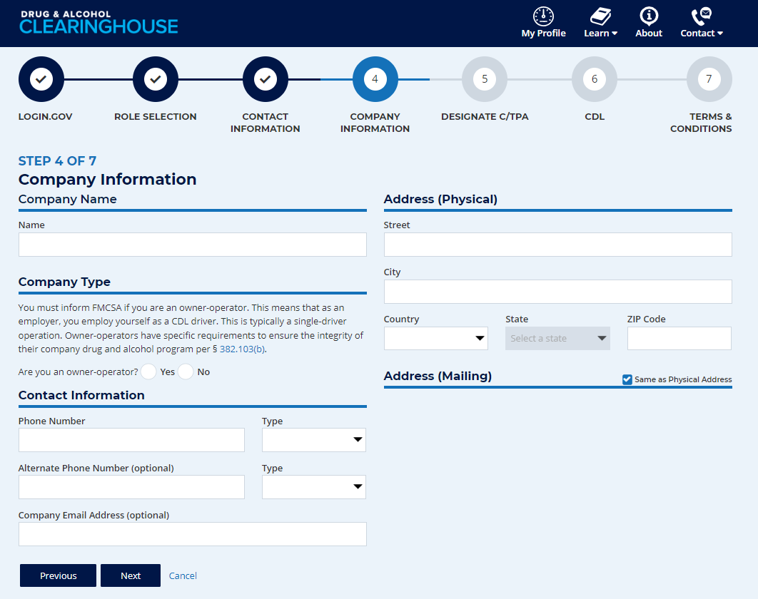
Registering for the Clearinghouse – Owner-Operators
Register as an employer
Link to your FMCSA Portal account (recommended)
Select “Yes” when asked if you are an owner-operator
Designate a C/TPA (required)
Must report violation information
May conduct queries
Add/verify your CDL information
Needed to view Violation History and respond to query consent requests
Notes:
Owner-operators who operate under their own USDOT Number will register as an employer.
You will have the option to enter your Portal User ID and password. This will pull your company information and contact information from other FMCSA systems. It will also link your Clearinghouse activity with your USDOT Number.
When asked, select “Yes” to indicate you are an owner-operator—an example of what this will look like is on the screen.
Note: If you register using your Portal account, this question will appear on the screen where you review your company information.
As we discussed previously, owner-operators are required to designate a C/TPA.
When assigning permissions, you MUST allow the C/TPA to report violation information on your behalf. You MAY also allow them to conduct queries on your behalf.
You will also have the option to add your CDL information. Having a verified CDL in your Clearinghouse is needed for you to view your Violation History and to respond to any query consent requests.

Slide 19
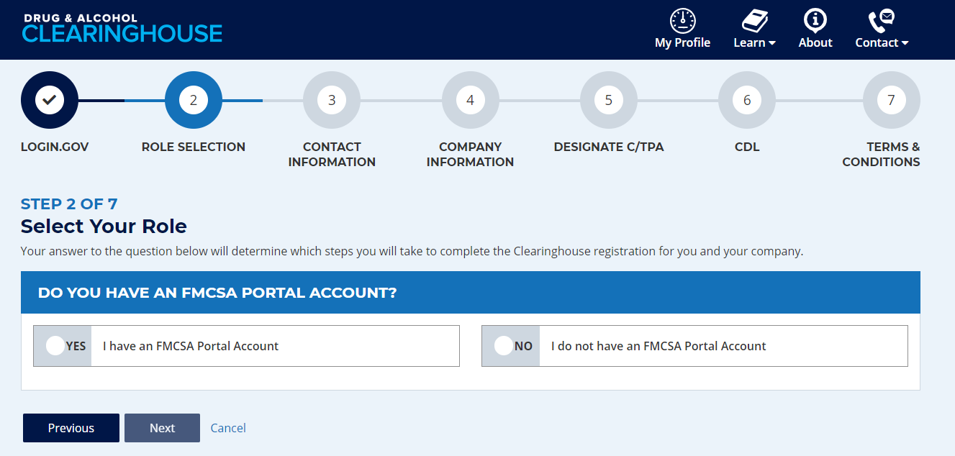
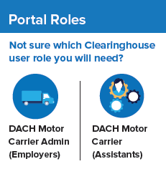
Registering with an FMCSA Portal Account – Employers
Employer Clearinghouse registration has two paths: FMCSA Portal users, and non-Portal users
An employer required to have a USDOT Number should have a Portal account
Your Portal account must have the correct user role
DACH Motor Carrier: can query, report
DACH Motor Carrier Admin: can query, report, designate C/TPA, indicate carrier type
To request an FMCSA Portal account, visit https://portal.fmcsa.dot.gov/login
Notes:
The path you take to register as an employer will depend on whether or not you have an FMCSA Portal account
If your company has a USDOT Number, you should have a Portal account. If you do not have one, or don’t know if you have one, visit the link on the screen to request an account.
A Portal account is given out to an individual person at a company. It is NOT a shared account used by multiple people at a company.
If your company has a USDOT Number, each employee who uses the Clearinghouse for your company should have their own Portal account, and their own login.gov account to access the Clearinghouse.
Once you have a Portal account, you need to be sure your Portal account has the correct user role before you register for the Clearinghouse.
The user roles are summarized here on the screen—be sure to request the user role that has the permissions you will need in the Clearinghouse.

Slide 20
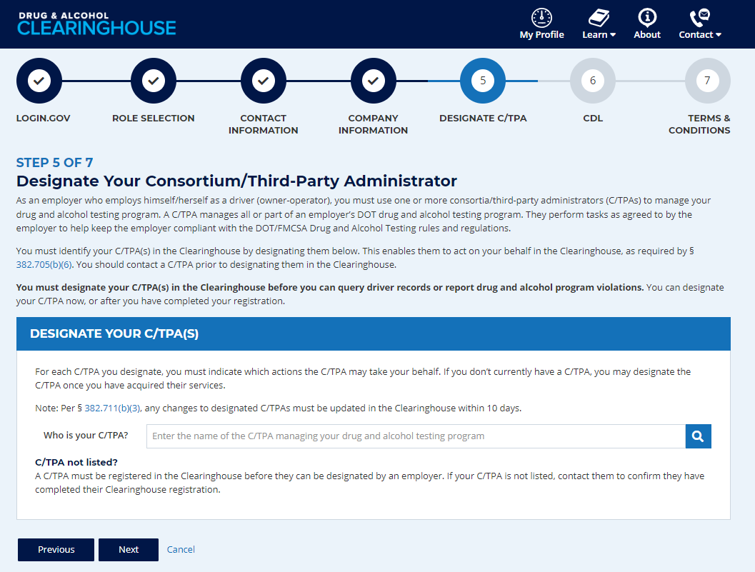
Designating a C/TPA
A C/TPA manages all, or part, of an employer's DOT drug and alcohol testing program
Employers should contact the C/TPA prior to sending them a designation request in the Clearinghouse.
Notes:
Employer Administrators will be prompted to designate a consortium/third-party administrator (C/TPA) during the registration process.
A C/TPA manages all, or part, of an employer's DOT drug and alcohol testing program and performs tasks as agreed to by the employer to assist in implementing the drug and alcohol testing program and to help keep the employer compliant with the DOT/FMCSA Drug and Alcohol Testing rules and regulations.
The Clearinghouse is not a tool for finding a C/TPA. If you need to find a C/TPA, search online for “consortium/third-party administrators”
You should have an agreement with your C/TPA outside the Clearinghouse before you designate them in the Clearinghouse.
C/TPAs should not accept a designation request from an employer they do not recognize.

Slide 21
Designating a C/TPA (continued)
C/TPAs must be registered in the Clearinghouse before they can be designated
Employers select the actions a C/TPA may take on their behalf
Owner-operators must designate at least one C/TPA to complete the following:
Report violations
Report RTD information
Notes:
A C/TPA must be designated by an employer in the Clearinghouse before the C/TPA can report violation information or query the Clearinghouse on behalf of the employer.
As covered previously, owner-operators must complete this step.
You do not need to designate a C/TPA to complete your registration, but you will not be able to access the Clearinghouse until you have designated one.
To designate your C/TPA after you have created your account, use the links in your Employee Dashboard.

Slide 22
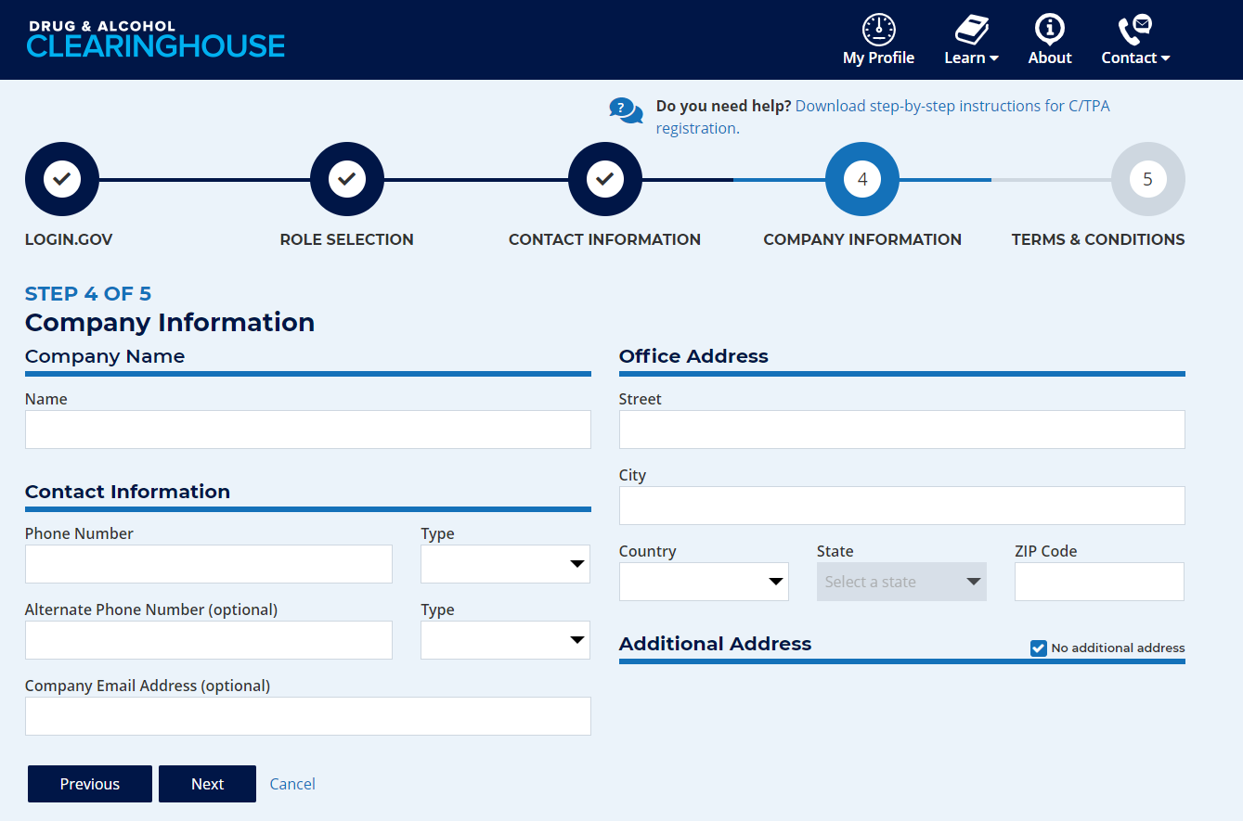
Registering for the Clearinghouse – C/TPA
Confirm you are the Clearinghouse Administrator
If not, you will need to register as a Clearinghouse Assistant. Contact your company’s Clearinghouse Administrator and ask them to send you an invitation to register
Company contact information will be used to populate the list of C/TPAs employers can choose from
Make sure your clients know how you have listed your company name

Slide 23
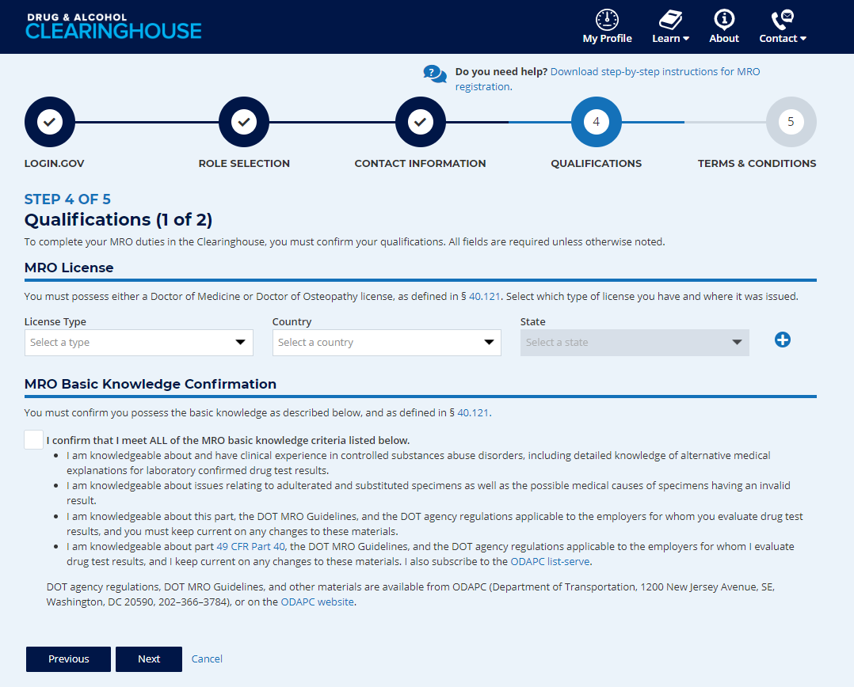
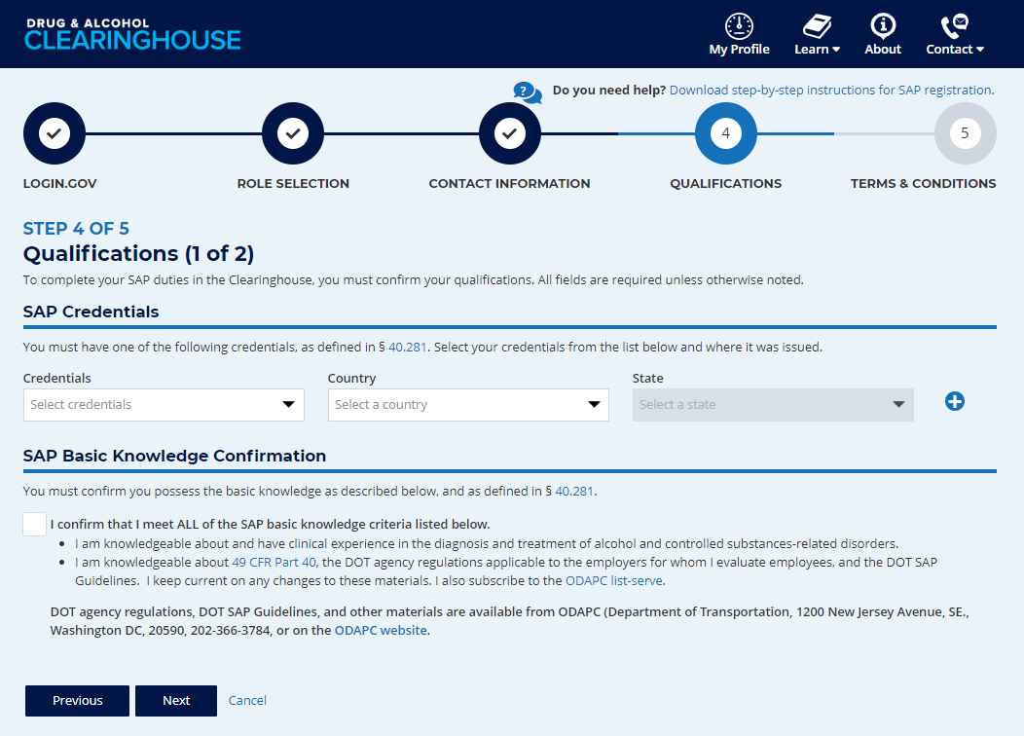
Registering for the Clearinghouse – MROs and SAPs
MROs: Enter your MRO license information and self-certify you meet all MRO qualifications, per § 40.121
SAPs: Enter your SAP credential information and self-certify you meet all SAP qualifications, per § 40.281
Notes:
If you will use the Clearinghouse on behalf of an MRO or SAP, they must send you an invitation to register as their Assistant.

Slide 24
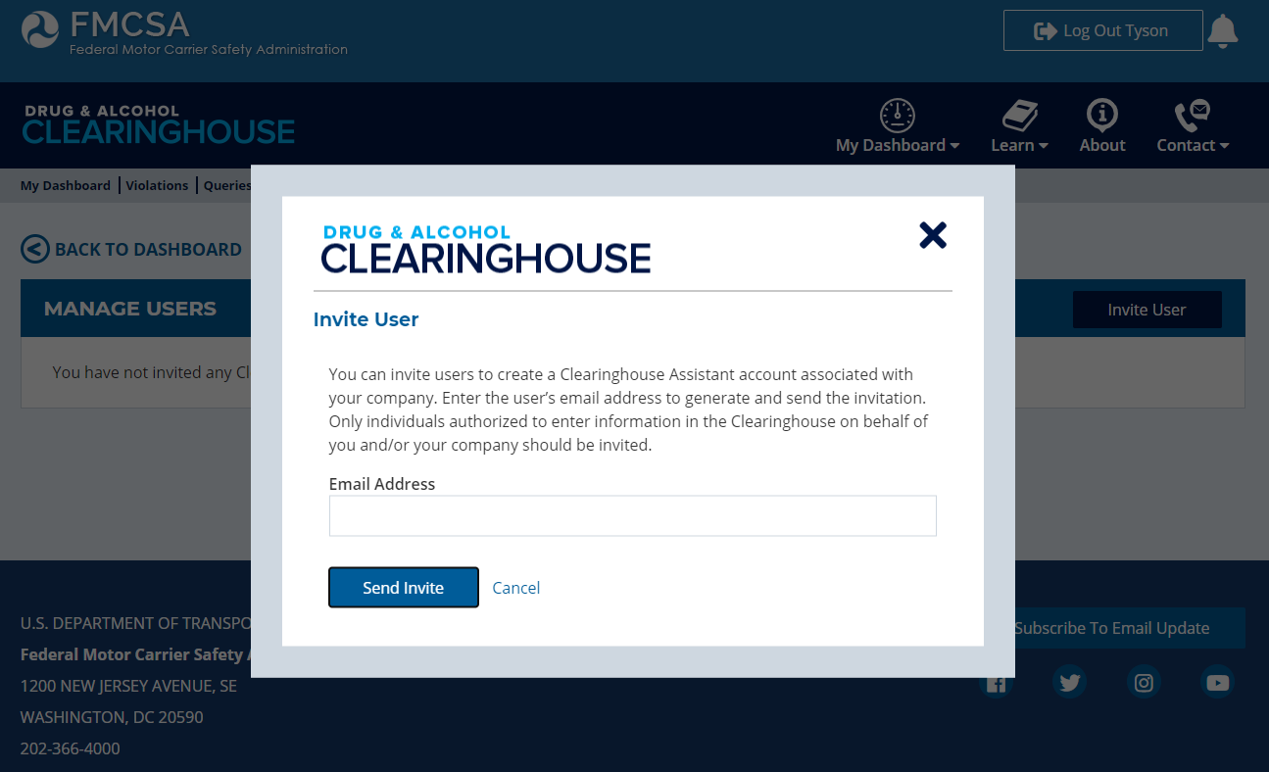
Inviting Other Users
Invite Assistant(s)
Ensure continuous access
Employers: not required for Portal users
Drivers do not have this feature
Additional Administrators register on the Clearinghouse website
Notes:
Once you have completed registration, you have the option to invite one or more Clearinghouse Assistants. Using this feature sends an email invitation to the Assistant. The Assistant must use the link in the email invitation to begin their Clearinghouse registration. This will link the Assistant’s Clearinghouse account to your organization.
Allowing multiple users to access the Clearinghouse on your organization’s behalf will ensure uninterrupted access to the Clearinghouse due to staff transitions, etc.
A note for Employers: Inviting an Assistant is not required if your company has a USDOT Number. Your users should go to the Clearinghouse website and register using their Portal User ID and password, which will allow the Clearinghouse to recognize the Clearinghouse User Role in each user’s Portal account.
If your organization will have more than one Administrator, all Administrators should go to the Clearinghouse website to begin the registration process.

Slide 25
Queries and Consent Requests
Notes:
Let’s now take a closer look at the requirements for conducting queries and obtaining driver consent.

Slide 26
Query Requirement
A query is a check of the Clearinghouse to ensure a CDL driver is not prohibited from performing safety-sensitive functions (such as operating a CMV) due to a drug and alcohol program violation
All queries require driver consent
Query Type | Description
Pre-employment query | Required for all newly hired CDL drivers
Annual query | Follows a rolling 12-month calendar Example: A query on driver J. Smith on December 1, 2022 satisfies the annual query requirement for J. Smith until December 1, 2023

Slide 27
Consent Requirements Based on Type of Query
Reason for Query | Type of Query | Consent Required
Annual query | Limited query | General consent, done outside the Clearinghouse May be electronic or wet signature, one time or unlimited Limited consent form must specify time range
Pre-employment query | Full query | Specific consent, provided electronically within the Clearinghouse Required for each full query of an individual driver
Download a sample general consent form.
If a driver refuses consent for any query, the query cannot be conducted and the driver is prohibited from performing safety-sensitive functions for that employer.
Notes:
Given the type of query, here are the requirements for driver consent.
Note that if a driver refuses consent (for any query) the query cannot be conducted and the driver is prohibited from performing safety-sensitive functions for that employer.

Slide 28
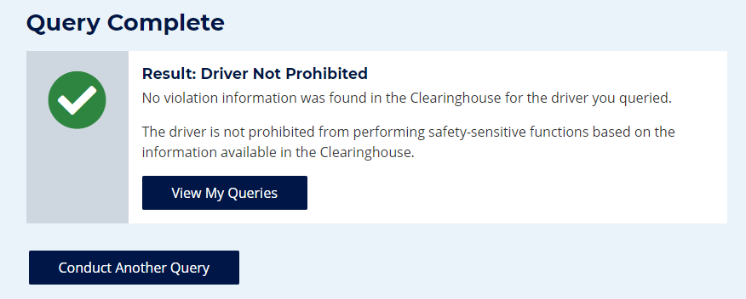
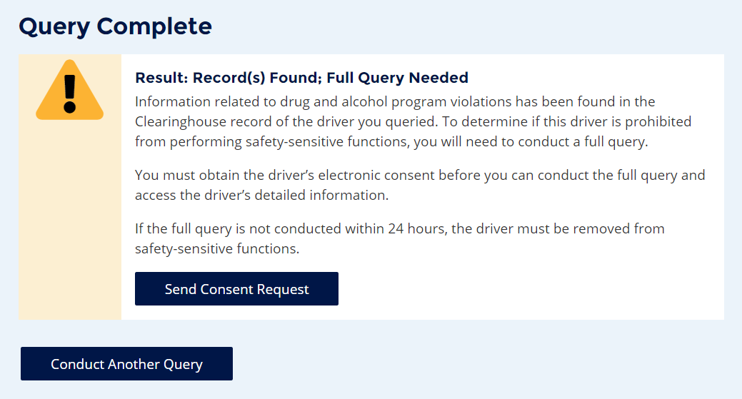
Query Results – Limited Query
“Record(s) Found” is not necessarily a notification that a queried driver is prohibited from performing safety-sensitive functions. The full query is needed to determine the driver’s eligibility status.
Notes:
Here are some sample query results for a limited query.
If a limited query determined that there is no violation information in the driver’s Clearinghouse record, the results will show “Driver Not Prohibited”
If information related to a drug and alcohol program violation is present in the driver’s Clearinghouse record, a notice appears stating “Full Query Needed”
Note that “Record(s) Found” is not a notification that a queried driver is prohibited from performing safety-sensitive functions. This could be information related to a closed RTD process, meaning the driver could be eligible to operate a CMV.
A full query is needed in this case to determine the driver’s eligibility status.
We’ll run through the results of a full query shortly.

Slide 29
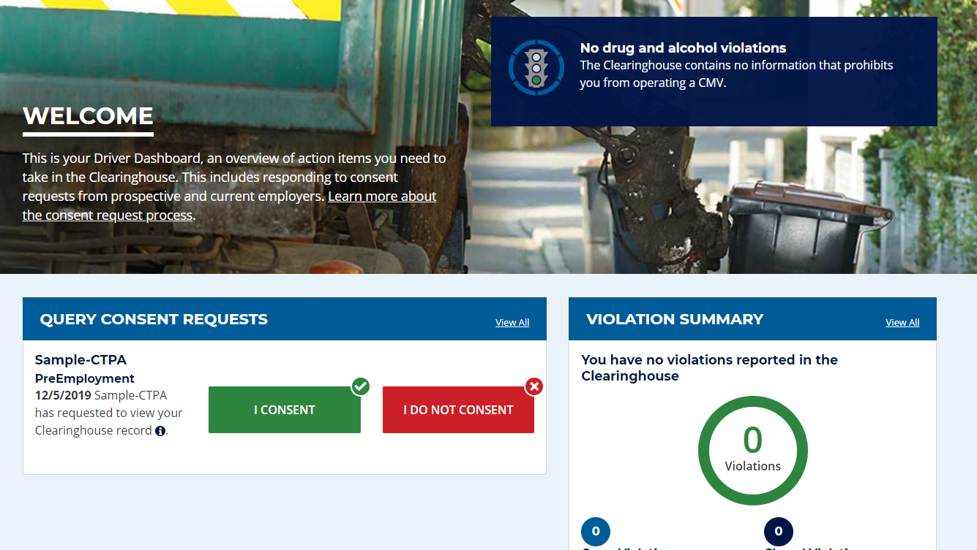
Drivers Responds to Consent Request in the Clearinghouse
Drivers will log in to the Clearinghouse to respond to a consent request
Query consent requests will be displayed on the Driver Dashboard
Notes:
If a full query is needed, a consent request will be sent to the driver. You can see an example of what that looks like in a driver’s Clearinghouse account on the screen. The driver will then respond to the query request.
Drivers must be registered in the Clearinghouse to provide consent for pre-employment and full queries.
Employers must obtain a driver’s consent before querying the driver’s violation information.
Again: Failure to provide consent to such a request will result in the driver being prohibited from performing safety-sensitive functions (including operating a CMV) for that employer, in accordance with 49 CFR 382.703(c).

Slide 30
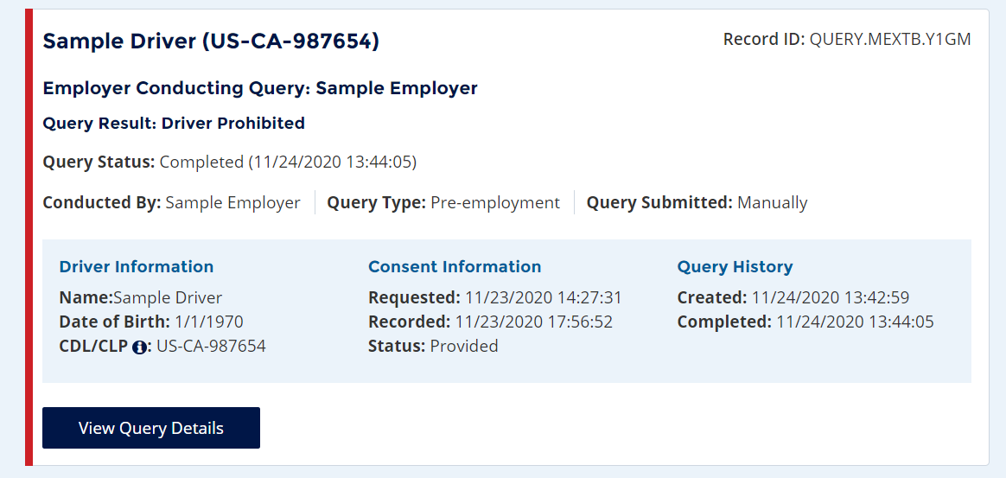
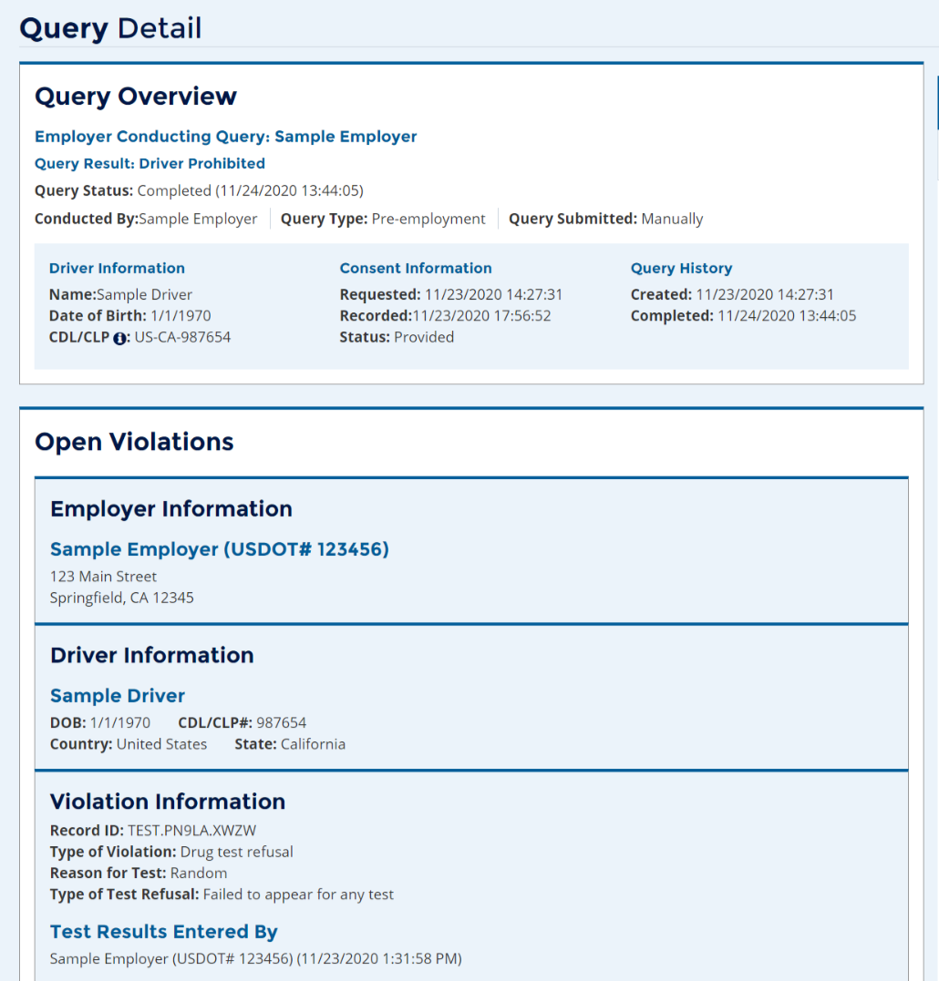
Employer Query Results – Full Query
Notes:
Now let’s discuss the results of a full query.
Once an employer receives a notification email that the driver has responded to the consent request, the employer will log into the Clearinghouse and view their Queries Conducted Page that provides an overview of each query.
Depending on their notification settings, the employer may also receive a notification within the Clearinghouse.
An employer can click on View Query Details to view the details of the query.
Drivers can also log in to view the details of the query and any other information in their own driver record. We’ll talk more about this shortly.
A pending query will display a yellow band until a driver has provided consent.
A red band, like the one you see on the screen, will be displayed if the query returns that the driver is prohibited from performing safety-sensitive functions at the time of the query.
After 24 hours of a limited result returning, if a driver has not provided consent it turns red.

Slide 31
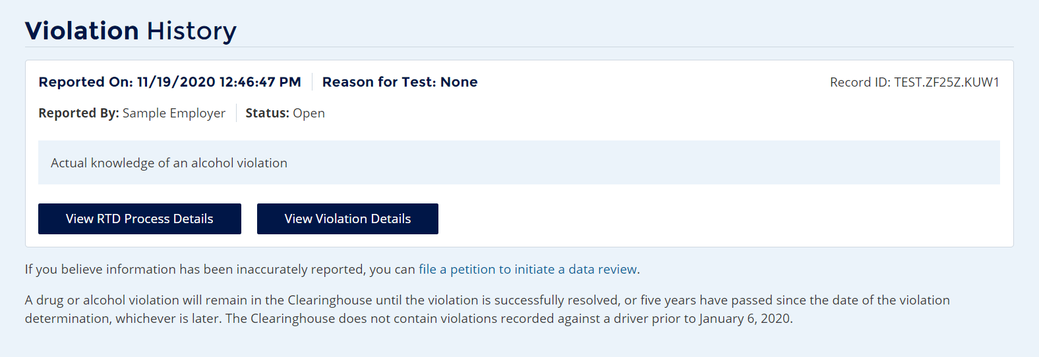
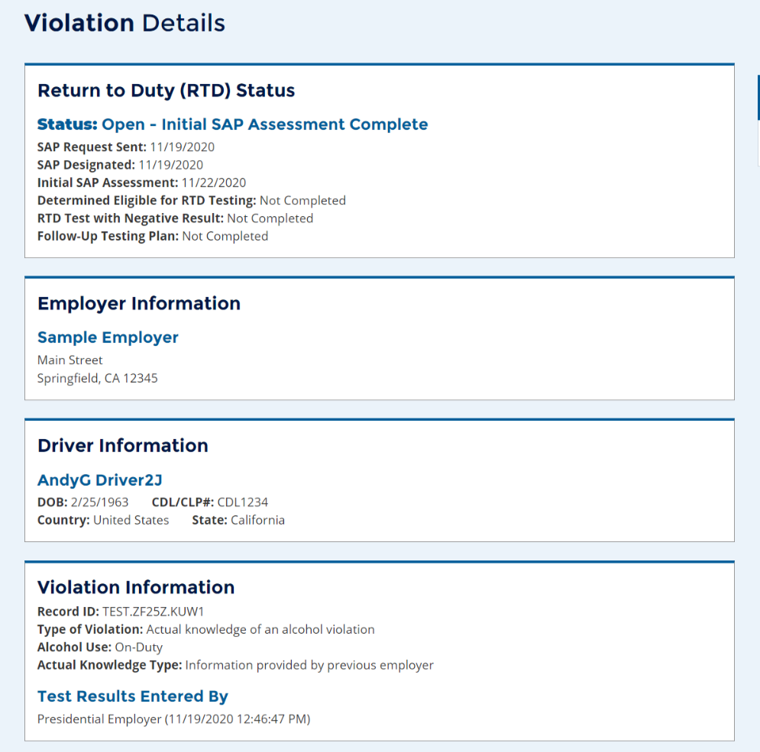
Driver’s View of Violation Information
Notes:
As we said earlier, registered drivers can always log into the Clearinghouse to review the information in their own driver record.
If you believe violation information has been inaccurately recorded, you can request a data review. We will go into more detail on that later in the webinar.
From your Violation History you can click View Violation Details to see the full information that will be shared with an employer who conducts a full query (with your consent).

Slide 32
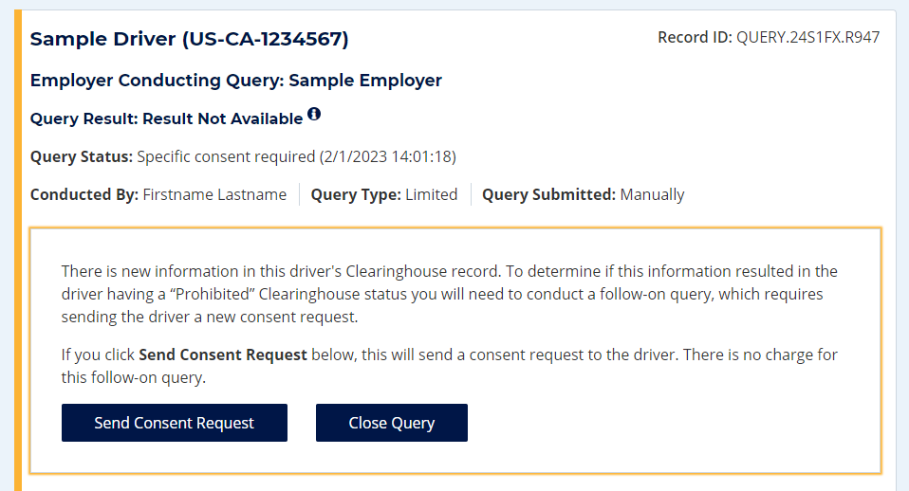
Notification of New Information
If information is entered or modified in a driver’s Clearinghouse record within 12 months of a previous query on that driver, the employer will be notified via email.
The Query History will also be updated to reflect this
A follow-on query is needed to determine if the new information results in the driver having a “prohibited” Clearinghouse status
Click Send Consent Request to request driver consent for the follow-on query
Employer is not charged for a follow-on query

Slide 33
Follow-on Query
Reason for Query | Type of Query | Consent Required
Follow-on query | Full query | Specific consent, provided electronically within the Clearinghouse
Employer should complete follow-on query within 24 hours.
If a driver refuses consent, the query cannot be conducted and the driver is prohibited from performing safety-sensitive functions for that employer.
“New information” is not necessarily a notification that a queried driver is prohibited from performing safety-sensitive functions. The full query is needed to determine the driver’s eligibility status.
Notes:
Given the type of query, here are the requirements for driver consent.
Note that if a driver refuses consent (for any query) the query cannot be conducted and the driver is prohibited from performing safety-sensitive functions for that employer.

Slide 34
Violations and Return-to-Duty
Notes:
Let’s take a closer look at reporting violation information in the Clearinghouse.

Slide 35
Reporting Violations – Employers and C/TPAs
What is the employer or designated C/TPA required to report?
REPORTING ENTITY | INFORMATION TO BE REPORTED TO CLEARINGHOUSE (must be reported by close of the third business day following the date the employer obtained the information)
Prospective/Current Employer of CDL Driver Or Service agent acting on behalf of Current Employer of CDL Driver | An alcohol confirmation test with a concentration of 0.04% or higher
 | Refusal to test (alcohol) as specified in 49 CFR 40.261
 | Refusal to test (drug) not requiring a determination by the MRO as specified in 49 CFR 40.191
 | Actual knowledge, as defined in 49 CFR 382.107, that a driver has used alcohol on duty, used alcohol within four hours of coming on duty, used alcohol prior to post-accident testing, or has used a controlled substance
 | Negative RTD test results (drug and alcohol testing, as applicable)
 | Completion of follow-up testing
Notes:
Here are the violations that employers, or their designated C/TPAs, are required to report in the Clearinghouse…[read slide]
Employer has 3 business days to report.

Slide 36
Actual Knowledge: What It Is, What It Isn’t
Actual knowledge must be based on one of the following:
Employer’s direct observation of an employee
A traffic citation for driving a CMV while under the influence of alcohol or controlled substances
An employee’s admission of alcohol or controlled substance use, except as provided in §382.121
A verified positive drug test result does not qualify as actual knowledge
When reporting actual knowledge, employers must upload supporting documentation. This may include:
Citation for DUI in a CMV that requires a CDL
Statement from the driver's supervisor
Statement from the driver
Notes:
We wanted to make sure everyone understands what does and does not qualify as actual knowledge of a violation.
To be recorded in the Clearinghouse, actual knowledge must be based on one of the following… [ read slide ]
Note that employers should NOT report positive drug test results as actual knowledge, as this can lead to duplicate reporting. Positive drug test results are entered by the medical review officer.
When reporting actual knowledge, you will be prompted to upload supporting documentation. This may include… [ read slide ]

Slide 37
Actual Knowledge Based on Issuance of a Citation
A CDL or CLP holder charged with a DUI in a CMV has violated part 382, subpart B, regardless of whether driver is convicted of the offense
Driver will be required to go through the return-to-duty (RTD) process
Violation will remain in the Clearinghouse for 5 years, or until the driver has completed RTD, whichever is later
Driver may submit documentary evidence of non-conviction to their Clearinghouse record

Slide 38
Reporting Violations – MROs and SAPs
What information is the MRO or SAP required to report?
 | INFORMATION TO BE REPORTED TO CLEARINGHOUSE | DEADLINE FOR REPORTING INFORMATION
MRO | Verified positive, adulterated, or substituted drug test result | Within two business days of making a determination or verification of a DOT-approved drug test
 | Refusal to test (drug) requiring a determination by the MRO as specified in § 40.191
 | Changes a verified drug test per part § 40.149 | Within one business day of making any change in the reported results
SAP | Identification of driver and date the initial assessment was initiated | By the close of the business day following the date of initial assessment
 | Date of determination of eligibility for RTD testing | By the close of the business day following the determination that the driver completed the RTD process
Notes:
You may be wondering about information MROs and SAPS will report in the Clearinghouse. This information is listed here [ read slide ]

Slide 39
Return-to-Duty (RTD) Process
A driver with a drug and alcohol program violation is prohibited from performing safety-sensitive functions, including operating CMVs, for any DOT-regulated employer until the RTD process is complete.
The steps drivers must take to complete the RTD process is established by 49 CFR part 40, subpart O, as follows:
1
Select a Substance Abuse Professional (SAP) and successfully complete education/ treatment plan.
2
Take the return-to-duty test.
3
When employer enters negative RTD test, Clearinghouse status is “not prohibited” and driver is eligible to resume performing safety-sensitive functions.
By November 18, 2024, as part of new Federal regulations, drivers with a “prohibited” status in the Clearinghouse will lose or be denied their State-issued commercial driving privileges.
Notes:
The RTD process is established by 49 CFR part 40, subpart O. In summary:
§ 40.287 What information is an employer required to provide concerning SAP services to an employee who has a DOT drug and alcohol regulation violation?
As an employer, you must provide to each employee (including an applicant or new employee) who violates a DOT drug and alcohol regulation a listing of SAPs readily available to the employee and acceptable to you, with names, addresses, and telephone numbers. You cannot charge the employee any fee for compiling or providing this list. You may provide this list yourself or through a C/TPA or other service agent.
Select a Substance Abuse Professional
The driver’s employer is required to provide them with a list of DOT-qualified Substance Abuse Professionals (SAPs).
The driver selects an SAP based on the driver’s own research.
The driver’s designated SAP will evaluate driver and provide recommendations for education/treatment.
Driver’s SAP will determine if the driver has successfully completed the education/treatment, therefore making the driver eligible for your return-to-duty test.
Take the return-to-duty test
The driver must be sent by their employer; only DOT-regulated employers, and not the employee, request the return-to-duty test.
If the driver is an owner-operator, the driver’s designated consortium/third-party administrator (C/TPA) must send
the driver for this test.
Once the driver’s Clearinghouse status is “not prohibited,” the driver is eligible to resume performing safety-sensitive functions.
The driver’s status will be updated when their employer enters their negative return-to-duty test result in
the Clearinghouse.
To remain in a “not prohibited” status, the driver’s employer must complete the follow-up testing plan with the driver as specified by the SAP, which must include a minimum of six unannounced follow-up tests in the first 12 months of returning to performing safety-sensitive functions.
If driver is an owner-operator, your designated C/TPA must complete the driver’s follow-up testing plan.
Information about your drug and alcohol program violation is retained in the Clearinghouse for five years
from the date of the violation determination or until the successful completion of the follow-up testing plan,
whichever is later.
By November 18, 2024, as part of new Federal regulations, drivers with a “prohibited” status in the Clearinghouse will lose or be denied their State-issued commercial driving privileges. We’ll talk about those new regulations next.

Slide 40
The Clearinghouse Second Final Rule
Federal Register Publication Date: October 7, 2021
Effective Date: November 8, 2021
Establishes requirements for State Driver Licensing Agencies (SDLAs) regarding commercial driving privileges
Compliance Date: November 18, 2024
Federal Motor Carrier Safety Regulation Parts Affected:
Parts 382, 383, 384, 390, and 392
NOV
18
2024
Read the Clearinghouse-II final rule at:
https://www.regulations.gov/document/FMCSA-2017-0330-0036
Notes:
The second Clearinghouse final rule established requirements for SDLAs’ access to and use of driver-specific drug and alcohol program violation information contained in the Drug and Alcohol Clearinghouse.

Slide 41
Clearinghouse-II: Commercial Driving Privileges
Beginning November 18, 2024:
CDL Downgrade
CDL Non-Issuance
When a CDL driver’s Clearinghouse status changes to “prohibited,” the SDLA must remove the commercial driving privileges
The commercial driving privilege will be reinstated if/when the driver’s status changes to “not prohibited”
Before any commercial licensing transaction, the SDLA will query the Clearinghouse
If the driver has a “prohibited” status, the SDLA will deny the commercial licensing transaction
Commercial licensing transactions include: issuing, renewing, transferring, or upgrading a CDL, or issuing, renewing, or upgrading a CLP
Notes:
SDLAs have until November 18, 2024 (compliance date) to comply with these requirements. In addition, FMCSA extends the compliance date for the requirement that SDLAs query the Clearinghouse prior to issuing, renewing, upgrading, or transferring a CDL from January 6, 2023 to November 18, 2024. SDLAs currently have the option to voluntarily query the Clearinghouse and may do so up until the compliance date.
CDL downgrades
SDLA will receive notification of a driver’s Clearinghouse status
SDLA to pull information from the Clearinghouse
FMCSA to push a notification to the SDLA
SDLA must initiate the process to remove a CLP or CDL privilege (downgrade) when notified of a driver’s Clearinghouse violation
FMCSA will notify the SDLA when a driver completes the RTD requirements and is no longer prohibited
If FMCSA removes a violation erroneously entered in the Clearinghouse, the SDLA will be notified
SDLA must reinstate commercial driving privilege
SDLA to expunge the driving record accordingly

Slide 42
Common Issues and Frequently Asked Questions

Slide 43
Common Issues – Incorrect Role
Issue | Possible Resolution
Employer cannot designate C/TPA | Employer is incorrectly registered as C/TPA or Driver – contact Clearinghouse Tech Support at https://clearinghouse.fmcsa.dot.gov/Contact
Employer cannot purchase query plan | Employer is incorrectly registered as C/TPA – contact Clearinghouse Tech Support at https://clearinghouse.fmcsa.dot.gov/Contact

Slide 44
Common Issues – Navigate Multiple Roles
If you are registered with multiple roles (ex: individual user that works for multiple employers)
While logged in, locate “Current Role” in page header
Use dropdown to switch between roles
If you do not see this dropdown, you do not have multiple roles

Slide 45
Common Issues – How to Add or Update CDL Information
Navigate to “My Dashboard > Manage > My Employer Profile” or “My Driver Profile” (depending on your user role)
Click Add Your CDL # above your contact information
If you already validated a CDL, the button will say “Update Your CDL #”
Enter information; enter CDL number without any spaces or dashes
Click Verify CDL
Notes:
FL CLPs: Call the CDL helpdesk in FL and they can manually add the pointer and should correct the validation issues.
850-617-2000 – the driver will need to tell the Help Desk that they have a CLP and the Clearinghouse will not validate it and they need it corrected.

Slide 46
Common Issues – Add or Update C/TPA
Navigate to “My Dashboard > Manage > C/TPAs”
Note: Employer role must be set to DACH Motor Carrier Admin in Portal
Can an employer designate more than one C/TPA?
Yes.

Slide 47
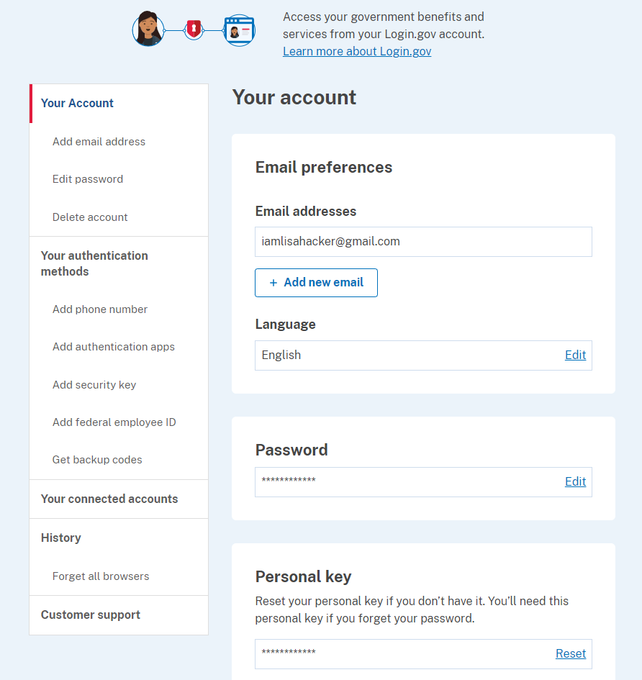
Common Issues – Login.gov
Change email address
Log in to https://secure.login.gov/.
Click + Add new email and follow instructions.
Change authentication method
Log in to https://secure.login.gov/.
In the side navigation, locate “Your authentication methods” and click the option you need.

Slide 48
Common Issues – Drivers
Issue | Possible Resolution
Driver cannot view query or violation information | Violation not yet reported – verify with MRO or Employer Violation had incorrect CDL information – verify with MRO or Employer Driver does not have a validated CDL in their Clearinghouse account – follow instructions to “Add a CDL #”
Driver cannot designate a SAP | Violation not yet reported – verify with MRO or Employer SAP is not registered in Clearinghouse – contact SAP Driver is entering incorrect name – verify you are entering the name is it was entered by the SAP during their Clearinghouse registration

Slide 49
FAQs – Driver Registration
Will every driver need to register in the Clearinghouse?
No. A driver will only need to register if they need to provide consent to the employer in the Clearinghouse for pre-employment/full queries.
If a driver is currently with an employer, never incurs a drug or alcohol violation, and never seeks other employment, then the driver does not need to register in the Clearinghouse.
Can an employer register their drivers in the Clearinghouse?
No. Individual drivers will need to register themselves. Registration and login will require users to complete the verification process.

Slide 50
FAQs – Violations
Does the Clearinghouse contain violations that occurred prior to January 6, 2020?
No, the Clearinghouse contains only violations that occur on or after January 6, 2020.
How long is the violation information retained in the Clearinghouse?
5 years or until the follow-up testing plan is successfully completed, whichever is later.
Can an MRO or employer report a drug and alcohol program violation if the driver is not registered for the Clearinghouse?
Yes. The Clearinghouse will associate the violation with a driver’s CDL information. This will be recorded even if the driver has not registered for the Clearinghouse.
Notes:
Before we move on, let’s look at some FAQs related to violation reporting.

Slide 51
FAQs – Violations (continued)
Is the driver’s social security number (SSN) or employee identification number (EIN) required when reporting violation information or querying the Clearinghouse?
No, per § 382.705, the employer shall provide the driver’s CDL number and State of issuance.
What information is required on the Custody and Control Form (CCF) or Alcohol Testing Form (ATF)?
The driver’s CDL number and state of issuance must be entered in lieu of the driver’s SSN or EIN, per § 382.123.
Will FAQs and other outreach materials about the Clearinghouse be updated?
Yes, the Clearinghouse website (https://clearinghouse.fmcsa.dot.gov) will be updated regularly with new information, including the factsheet and FAQs. In addition, you will be able to sign up for email updates.

Slide 52
FAQs – Violations (continued)
Who will record positive alcohol results for an owner/operator?
The designated C/TPA would be responsible to record this violation information regarding the owner/operator they work with.
An owner/operator may view and query their own information.
An owner/operator will be required to self-identify as an owner/operator and will be required to designate a C/TPA to access their Clearinghouse account.

Slide 53
FAQs – Inaccurate Violation Information
What information may be challenged by the driver?
The accuracy of the information reported.
Report of employer’s actual knowledge the driver received a traffic citation for driving a CMV while under the influence of drugs or alcohol if it did not result in a conviction.
Accuracy of test results and refusals may not be challenged.
How does a driver change or remove inaccurate data?
The driver may submit a petition via FMCSA’s DataQs system.
FMCSA will review petition and notify driver of decision to remove, retain, or correct information in the Clearinghouse and the reason for decision.
If the driver believes a petition decision was made in error, he/she may submit a request for an Administrative Review.
Request must include an explanation why he/she believes FMCSA made an error in their decision.
Driver informed of decision.
Decision will constitute as the final Agency action.
Notes:
To review, there are only 3 reasons that a Clearinghouse record can be amended under 382.717:
a data entry error (e.g., wrong name, wrong CDL number, wrong test result, etc.) has occurred;
a DUI citation which was the basis of an actual knowledge report did not result in a conviction; and
an employer reporting either a failure to appear refusal or actual knowledge violation did not comply with the respective reporting requirements (382.705(b)(3) & (4)).
Within 45 days of receiving a complete petition, FMCSA will inform the driver, in writing (email or letter), of its decision to retain, remove, or correct the information in the database and provide the basis for the decision.
Example of denied petitions: drivers were arguing they had not refused, based on their versions of the facts.
A driver must provide evidence (e.g., notice of suspension) to support the claim that information recorded in the driver’s Clearinghouse record is inaccurate. If the driver fails to provide sufficient evidence, his or her petition will be closed with no further action taken.
A driver may request an expedited review if the inaccuracy is currently preventing him or her from performing his or her job duties per § 382.717(e). FMCSA will respond to expedited reviews within 14 days. Note that the driver must provide evidence (e.g., notice of suspension) in order to request an expedited review.

Slide 54
FAQs – Canadian and Mexican Drivers
Are Canadian and Mexican drivers conducting operations in the United States subject to the Clearinghouse requirements?
Yes, only Canadian and Mexican drivers operating in the United States are required to comply with FMCSA drug and alcohol testing requirements and must comply with the Clearinghouse final rule.
Must Canadian and Mexican employers report drug and alcohol program violations to the Clearinghouse?
Yes, only Canadian and Mexican employers operating in the United States are required to comply with FMCSA drug and alcohol testing requirements and must report drug and alcohol violations to the Clearinghouse.

Slide 55
FAQs – Other Modes and Non-CDL Drivers
Will a prospective employee’s drug and alcohol violation history with other DOT modes be available in the Clearinghouse?
No, the Clearinghouse will contain only drug and alcohol program violation information for employees subject to the testing requirements under the Federal Motor Carrier Safety Regulations in 49 CFR part 382.
Are employers of non-CDL drivers who operate CMVs required to query or report violations to the Clearinghouse?
No. Only employers who employ drivers subject to 49 CFR parts 382 and 383 must query or report information to the Clearinghouse.

Slide 56
FAQs – Query Plans
Why purchase a query plan?
Employers are charged a fee for conducting queries in the Clearinghouse.
Employer must purchase a query plan to ensure they or their designated C/TPAs can conduct queries.
Can C/TPAs purchase a query plan?
No, only employers can purchase query plans.
How does the employer purchase a query plan?
Query plans may only be purchased from FMCSA on the Clearinghouse website. Download the How to Purchase a Query Plan job aid factsheet to learn more.
Which query plan is right for me?
Query bundles
Purchase the number of queries equal to the number of your current employees (satisfy your annual queries needs)
Purchase additional query plans, as needed
Unlimited query subscription
High volume users

Slide 57
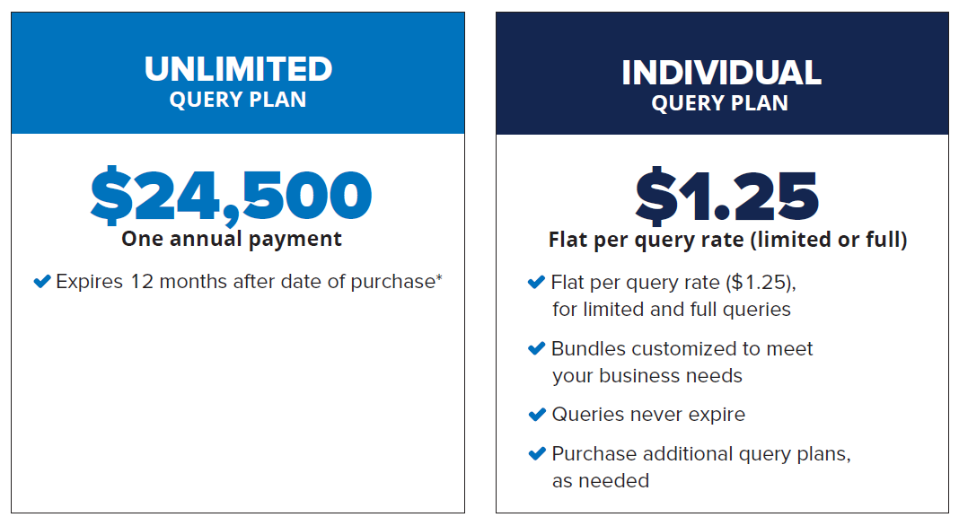
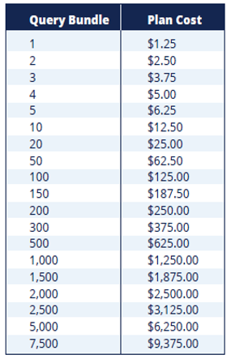
FAQs – Query Plans (continued)
Recommended for High-volume users

Slide 58
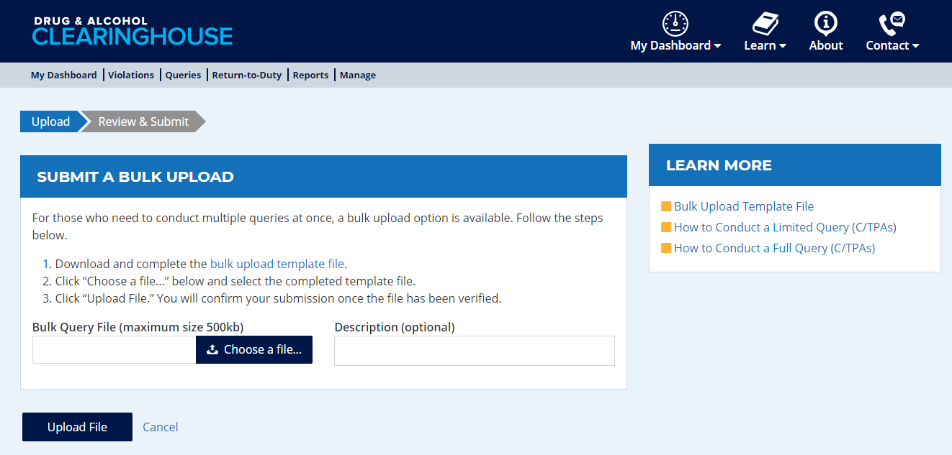
FAQs – Bulk Queries
How does an employer or consortium/third-party administrator (C/TPA) submit multiple query consent requests at one time?
Log in to the Clearinghouse. Navigate to “My Dashboard > Queries > Submit a Bulk Upload.”
Download the Bulk Upload Template File.
Edit the template file to include the appropriate driver information.
Note: C/TPAs: If you work with multiple employers, you will need to upload a separate file for each employer.
Click Choose a file…, select your file, and click Upload File.

Slide 59
FAQs – Return-to-Duty
Will a driver’s follow-up testing plan be available in the Clearinghouse?
No, follow-up testing plans will not be uploaded into the Clearinghouse.
When a prospective employee has not completed a follow-up testing plan prescribed by the SAP, the subsequent new employer must obtain the follow-up testing plan from the previous employer as required in § 382.413, continue administering the remaining follow-up tests, and report the date the follow-up testing plan was complete to the Clearinghouse.
Will follow-up testing be tracked within the Clearinghouse?
No, follow-up testing will not be tracked in the Clearinghouse.
The follow-up testing plan completion date is reported to the Clearinghouse.
However, if there is a positive follow-up test result, it must be reported as a new violation.
The RTD process would be re-initiated after the new violation is entered.

Slide 60
FAQs – General
If a driver is on the road and unable to access a computer, how can the driver access the Clearinghouse?
The Clearinghouse is mobile-friendly. The driver will be able to access the Clearinghouse from a smart phone, log in and view their information as well as provide consent and identify their substance abuse professional, if applicable.
Will FAQs and other outreach materials about the Clearinghouse be updated?
Yes, the Clearinghouse website at https://clearinghouse.fmcsa.dot.gov will be updated regularly with new information, including the factsheet and FAQs. In addition, you will be able to sign up for email updates.

Slide 61
Are you registered? If not, register today.
Register your company and/or yourself
Designate C/TPA (employers, if applicable)
Set up Assistants (employers, C/TPAs, SAPs, MROs)
Encourage drivers to register

Slide 62
Next Steps
Register
For information to get started, visit https://clearinghouse.fmcsa.dot.gov/Register
For more information:
Visit the Clearinghouse Learning Center at https://clearinghouse.fmcsa.dot.gov/Learn for resources and answers to common questions
Contact us:
Division Contact Name, Division Office
Division Office Phone Number
Contact Clearinghouse Team:
https://clearinghouse.fmcsa.dot.gov/Contact
Call 844-955-0207

