Slide 1
Note for Division Staff: Tailor your presentation
This presentation is a comprehensive set of slides that you can customize and use to educate Clearinghouse stakeholders. This may include CDL drivers, their employers (including motor carriers), consortia/third-party administrators (C/TPAs), medical review officers (MROs), and substance abuse professionals (SAPs).
Look at the section titles, then select the slides that will be most relevant to your audience.
Update the Agenda slide to reflect only the topics you will cover.
Tailor the slide notes as needed.
Delete this slide and text shown in red (see title slide and “Contact Us” on final slide) before presenting to your audience.

Slide 2
[Event Name] [Audience]
[Date]

Slide 3
1
4
OVERVIEW OF THE CLEARINGHOUSE
VIOLATIONS
About the Congressional mandate and what it means
Which violations are reported to the Clearinghouse
2
5
REGISTRATION
COMMON ISSUES & FREQUENTLY ASKED QUESTIONS
Creating a Clearinghouse account
Answers to commonly asked questions and learn how you can register and get technical support
3
QUERIES AND CONSENT REQUESTS
6
CLEARINGHOUSE RULE II
Query and consent requirements in the Clearinghouse
Overview of the final rule covering State Clearinghouse requirements for non-issuance and downgrading CDLs

Slide 4
Overview of the Clearinghouse
Notes:
Let’s begin with an explanation of what the Clearinghouse is.

Slide 5
The Clearinghouse Initial Rule
Mandated by Congress (MAP-21, Section 32402)
Published December 5, 2016
Established requirements for the Clearinghouse
Implemented on January 6, 2020
Read the Clearinghouse final rule at:
www.fmcsa.dot.gov/regulations/commercial-drivers-license-drug-and-alcohol-clearinghouse
Notes:
We will discuss the Clearinghouse Second Rule, which has an implementation date of November 8, 2024, a little later in this presentation.

Slide 6
Who is required to use the Clearinghouse?
Drivers who hold commercial driver’s licenses (CDLs) or commercial learner’s
permits (CLPs)
Employers of CDL drivers who operate commercial motor vehicles (CMVs)
Consortia/Third-Party Administrations (C/TPAs)
Medical Review Officers (MROs)
Substance Abuse Professionals (SAPs)
State Drivers Licensing Agencies (SDLAs)

Slide 7
The FMCSA Commercial Driver’s License Drug and Alcohol Clearinghouse
Driver consent
Record
Retain
Query
Employers and medical review officers report violation information to the Clearinghouse (positive tests, refusals to test, actual knowledge)
Secure database retains the violation and CDL/CLP number
Includes driver’s status in return-to-duty (RTD) process
Employers and C/TPAs query the Clearinghouse for violation
information, with driver consent
FMCSA uses data for enforcement purposes
State enforcement agencies will receive driver eligibility status (i.e., Prohibited/Not Prohibited)
Drivers can access only their own information
Notes:
The Clearinghouse will associate a violation with a driver’s CDL information. This will be recorded even if the driver has not registered for the Clearinghouse.

Slide 8
Increasing safety on our Nation’s roadways
Real-time access to reported violation information for select registered users
Easier for employers to meet pre-employment investigation and reporting obligations
Safer Roadways
More difficult for drivers to conceal drug and alcohol violations from employers
More insight into employer compliance with drug and alcohol testing rules

Slide 9
Am I covered by the Clearinghouse rule?
All CDL drivers who operate CMVs on public roads and their employers and service agents. This includes, but is not limited to:
Interstate and intrastate motor carriers, including passenger carriers
School bus drivers
Construction equipment operators
Limousine drivers
Municipal vehicle drivers (e.g., waste management vehicles)
Federal and other organizations that employ drivers subject to FMCSA drug and alcohol testing regulations (e.g., Department of Defense, municipalities, school districts)
Government entities are not required to obtain a USDOT Number under 49 CFR Part 390, however they are subject to the Controlled Substance and Alcohol Testing regulations in 49 CFR Part 382
Learn more about the specific actions each user can take at:
https://clearinghouse.fmcsa.dot.gov/Resource/Index/User-Roles
Notes:
Which drivers are covered by the Clearinghouse?
CDL drivers = Any driver who holds a CDL (CDL driver) and meets the requirements of the CDL standards (49 CFR Part 383), and the FMCSA Drug and Alcohol Testing Program (Part 382). References to CDL drivers also includes CLP drivers.
For the purposes of this presentation, we use the term “Employers.” Most employers are motor carriers or owner-operators, but the term “employers” encompasses anyone who employs someone with a CDL or CLP.
We also use the term “consortia/third-party administrators” or “C/TPAs” to refer to organizations that employers designate to manage or conduct their drug and alcohol compliance programs. You may also hear these agencies referred to as “service agents” in official rulemaking.

Slide 10
Driver Requirements
Register
Be sure to add/verify your CDL
Consent
Respond to consent requests for full queries from current and potential employers
Designate
Designate a SAP, if needed, to record RTD information
Needed to view Violation History, respond to query consent requests, and designate a SAP
Note: All pre-employment queries are full queries
This includes positive tests, test refusals, and actual knowledge
Failure to provide consent to a request for a full query will result in the driver being prohibited from performing safety-sensitive functions (including operating a CMV) for that employer, in accordance with 49 CFR 382.703(c).
Notes:
Here is an overview of the actions that drivers are responsible for completing in the Clearinghouse.
Drivers only need to register for the Clearinghouse to view their own violation history and respond to query consent requests. If applicable, a driver also needs to be registered to designate a substance abuse professional.
During registration you’ll add and verify your CDL information. This step is required to view your violation history and respond to query consent requests from an employer or C/TPA.
Drivers must also respond to an electronic consent request in the Clearinghouse for a full query from a current or potential employer. This includes all pre-employment queries.
Failure to provide consent to such a request will result in the driver being prohibited from performing safety-sensitive functions (including operating a CMV) for that employer, in accordance with 49 CFR 382.703(c).
This means that if you apply for a new job as a CDL driver, you will receive a consent request for a full query, and you will need to respond to that consent request in order to be hired to operate a CMV.
If you do not plan on changing employers, you may still need to register for the Clearinghouse if your employer chooses to conduct a full query to access your Clearinghouse record.

Slide 11
Student Driver Requirements
Register
Student drivers enrolled in independent trucking schools register as a Student Driver.
Consent
Conduct pre-employment query on self
Designate
Select a C/TPA (required).
C/TPA must report violations and RTD information
Student drivers may designate C/TPA to conduct queries, or conduct their own
Must be completed before training on public roads
Notes:
Here are student driver required actions in the Clearinghouse:
Student drivers enrolled in independent trucking schools register as a Student Driver.
Student drivers must select a C/TPA. Please note, the student driver must contact the C/TPA before designating them in the Clearinghouse.
Student drivers must purchase a query plan to conduct their pre-employment query.
Student drivers and instructors must provide electronic consent for pre-employment queries or other full queries conducted by an employer or C/TPA.
Take a pre-employment drug test: Student drivers must be enrolled in a random testing pool during their time spent performing safety-sensitive functions during CDL training.

Slide 12
Employer Requirements
Register
Link to your FMCSA Portal account (optional)
Record
Report CDL driver drug and alcohol program violations
Query
Check if driver is prohibited from operating a CMV
Designate
Test refusals, actual knowledge
Pre-employment and annual
Designate a C/TPA (optional)
C/TPA may conduct queries, report violations and RTD information on your behalf
Notes:
Next, we’ll talk about what actions employers are responsible for completing in the Clearinghouse.
Employers will register and link their Clearinghouse with their Portal account, if applicable.
They’ll also report CDL driver drug and alcohol program violations including positive tests, test refusals, and actual knowledge.
Employers must also conduct pre-employment and annual queries to check if a driver is prohibited from operating a CMV.
Driver consent is required before a query can be conducted.
Employers can also designate a consortium/third party administrator, if desired, and authorize the actions the C/TPA will complete on their behalf.
A C/TPA may be designated during registration, or after the employer has completed registration.

Slide 13
Owner-Operator Requirements
Register
Register as an employer, indicate you are an owner-operator
Query
Check if a driver is prohibited from operating a CMV
Designate
Designate a C/TPA (required)
Link to your FMCSA Portal account (option)
Add/verify your CDL (optional)
Pre-employment queries on any new drivers
Annual queries on all drivers, including yourself
C/TPA must report violations and RTD information
Owner-operators may designate C/TPA to conduct queries, or conduct their own
Notes:
Now let’s talk about owner-operator requirements.
If you are an owner-operator, you’ll register as an employer and indicate that you are an owner-operator. During registration you will link your Clearinghouse with your Portal account, if applicable.
You can also add and verify your CDL number, if applicable.
Owner-operators must conduct pre-employment and annual queries to check if a driver is prohibited from operating a CMV.
Driver consent is required before a query can be conducted.
Owner-operators MUST designate at least one consortium/third party administrator to report violations and RTD information. The C/TPA may be designated to conduct queries.
A C/TPA may be designated during registration, or after you have completed your registration, BUT you cannot complete any actions in the Clearinghouse until you have designated at least one C/TPA.

Slide 14
MRO and SAP Requirements
Register
Self-certify you meet all MRO qualifications per §40.121
Report
Positive, adulterated, substituted drug tests or test refusals
MRO
Register
Self-certify you meet all SAP qualifications per §40.281
Driver must designate you in the Clearinghouse
Report
Enter RTD information: date of initial SAP assessment, and date driver determined eligible for RTD testing
SAP
Notes:
Here is an overview of the actions that MROs and SAPs are responsible for completing in the Clearinghouse.
MROs must register and self-certify that they meet all MRO qualifications per §40.121
They also report positive, adulterated, substituted drug tests or test refusals per §40.191
SAPS must register and self-certify that they meet all SAP qualifications per §40.281
SAPs will also enter certain information about a driver’s return-to-duty process including the date of the initial SAP assessment and the date the SAP determines the driver is eligible for RTD testing
Before you can enter RTD information about a driver, you will need to approve the driver’s request in the Clearinghouse to become their designated SAP

Slide 15
Registration
Notes:
Let’s now take a closer look at the requirements for conducting queries and obtaining driver consent.

Slide 16
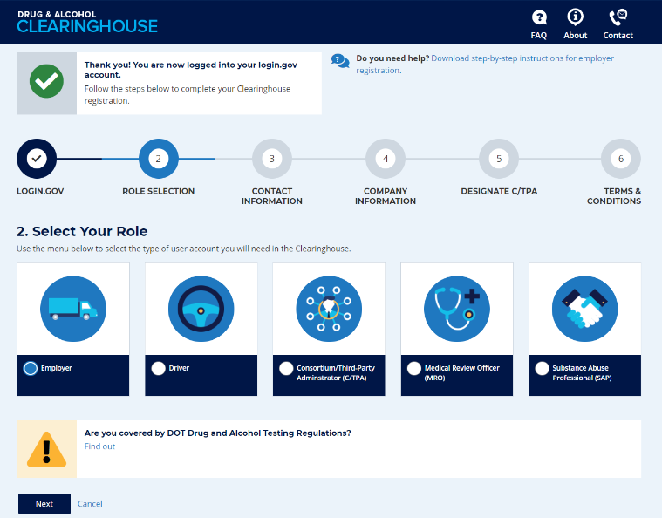
Registering for the Clearinghouse
Must have a login.gov account to register for the Clearinghouse
When selecting a method for second factor authentication do not select “backup codes”
After you have logged in to your login.gov account, select your user role
Notes:
Registration has been open on the Clearinghouse website since October 1, 2019.
Instructional job aids are available to help walk through registration for every user type.
We have had some frequently asked questions about the registration process, so we do have some tips for you to follow.
We recommend that users do not select the “backup codes” option as an authentication method, as they can only be used a limited number of times. This is meant as a fallback, in case none of the other methods (phone call, text message) work for you. These are also considered the least secure option by login.gov.
The back up code creates 10 codes that can only be used one time. If you have used 9 of these codes, you should generate a new set before using the last code.
If a user chooses the backup codes option but is unable to provide a backup code during the log in process, the user must delete the login.gov account, which requires a 24 hour waiting period, before creating a new login.gov account.
If you do need to delete your login.gov account and experience any difficulty logging into the Clearinghouse with your new login.gov account, send an email to clearinghouse@dot.gov for assistance.

Slide 17
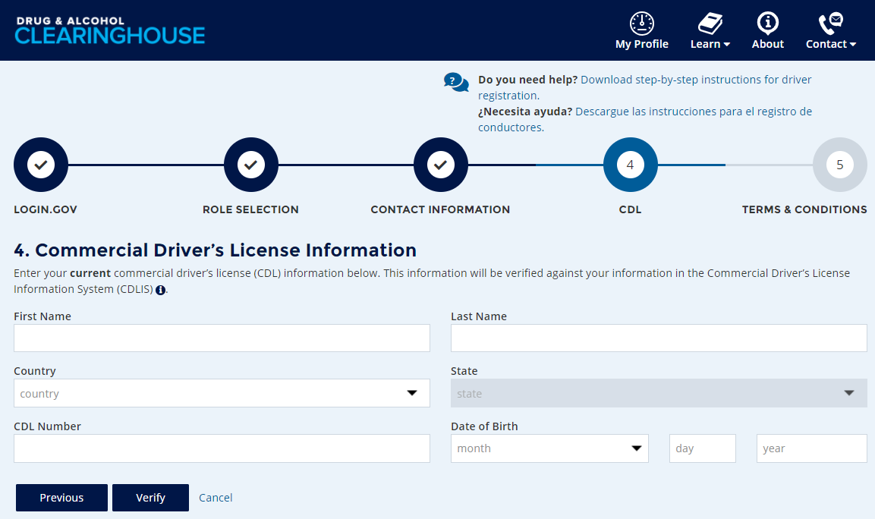
Registering for the Clearinghouse – Drivers
Enter and validate your current commercial driver’s license (CDL) or commercial learner’s permit (CLP) information
Note: This is required to view your Clearinghouse record and respond to query consent requests
Include any leading zeroes
Try entering with or without special characters (spaces, hyphens), as requirements vary by State

Slide 18
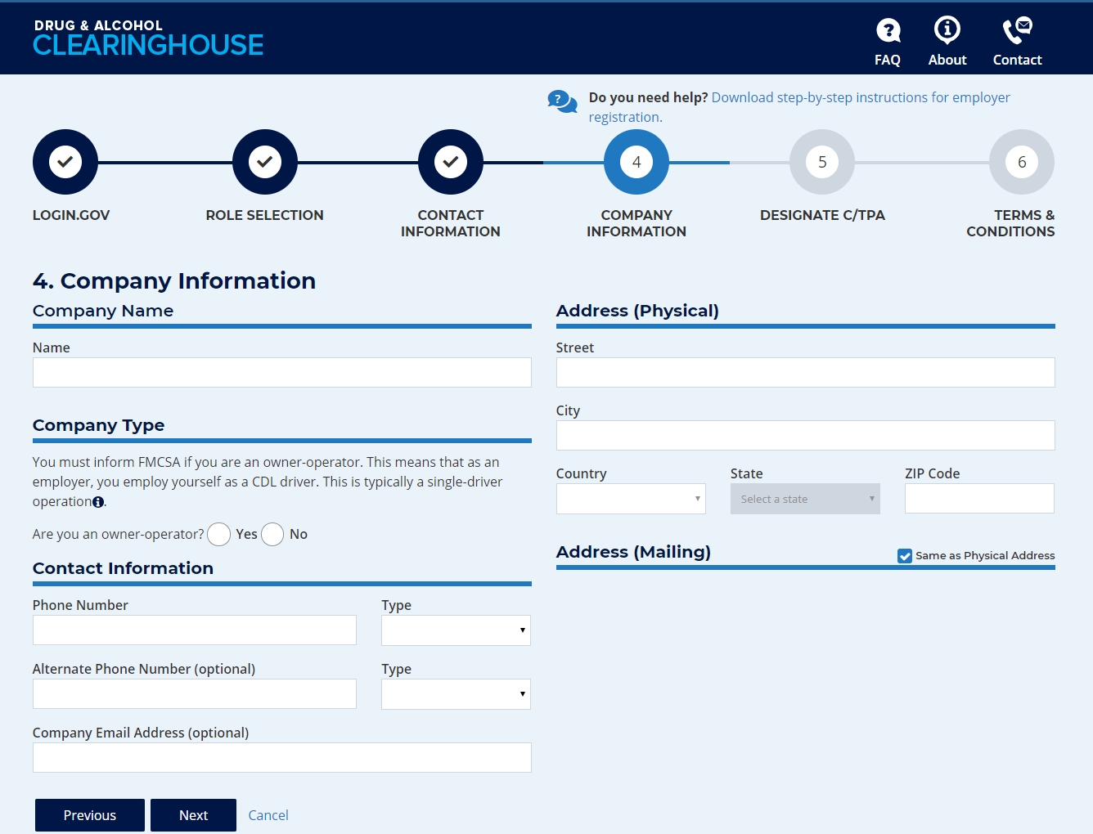
Registering for the Clearinghouse – Owner-Operators
Register as an employer
Link to your FMCSA Portal account (optional)
Select “Yes” when asked if you are an owner-operator
Designate a C/TPA (required)
Must report violation information
May conduct queries
Add/verify your CDL information
Needed to view Violation History and respond to query consent requests
Notes:
Owner-operators who operate under their own USDOT Number will register as an employer.
You will have the option to enter your Portal User ID and password. This will pull your company information and contact information from other FMCSA systems. It will also link your Clearinghouse activity with your USDOT Number.
When asked, select “Yes” to indicate you are an owner-operator—an example of what this will look like is on the screen.
Note: If you register using your Portal account, this question will appear on the screen where you review your company information.
As we discussed previously, owner-operators are required to designate a C/TPA.
When assigning permissions, you MUST allow the C/TPA to report violation information on your behalf. You MAY also allow them to conduct queries on your behalf.
You will also have the option to add your CDL information. Having a verified CDL in your Clearinghouse is needed for you to view your Violation History and to respond to any query consent requests.

Slide 19
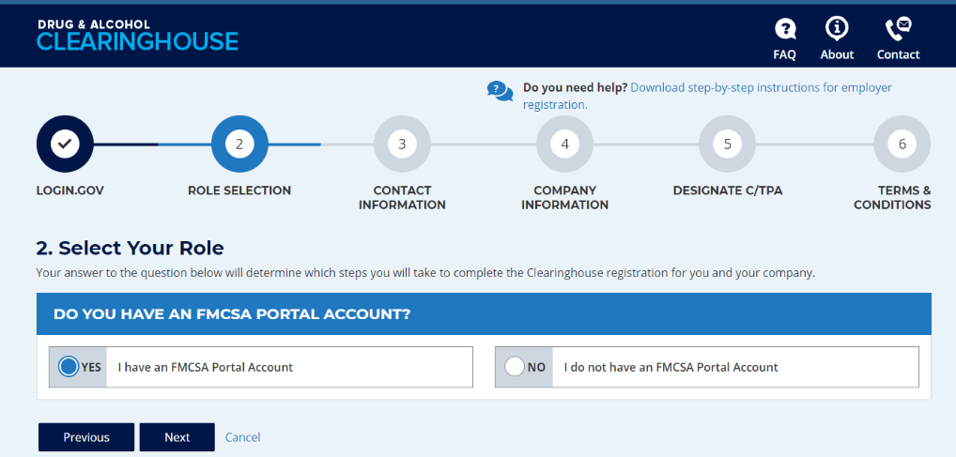
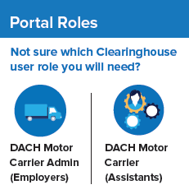
Registering with an FMCSA Portal Account – Employers
Employer Clearinghouse registration has two paths: FMCSA Portal users, and non-Portal users
If you have, or should have, a USDOT Number, you should have a Portal account
Your Portal account must have the correct user role
DACH Motor Carrier Can query, report
DACH Motor Carrier Admin Can query, report, designate C/TPA, indicate carrier type
To request an FMCSA Portal account, visit https://portal.fmcsa.dot.gov/login
Notes:
The path you take to register as an employer will depend on whether or not you have an FMCSA Portal account
If your company has a USDOT Number, you should have a Portal account. If you do not have one, or don’t know if you have one, visit the link on the screen to request an account.
A Portal account is given out to an individual person at a company.. It is NOT a shared account used by multiple people at a company.
If your company has a USDOT Number, each employee who uses the Clearinghouse for your company should have their own Portal account, and their own login.gov account to access the Clearinghouse.
Once you have a Portal account, you need to be sure your Portal account has the correct user role before you register for the Clearinghouse.
The user roles are summarized here on the screen—be sure to request the user role that has the permissions you will need in the Clearinghouse. .

Slide 20
Designating a C/TPA
A consortium/third-party administrator (C/TPA) manages all, or part, of an employer's DOT drug and alcohol testing program
Employers should contact the C/TPA prior to sending them a designation request in the Clearinghouse.
Notes:
Employer Administrators will be prompted to designate a consortium/third-party administrator (C/TPA) during the registration process.
A C/TPA manages all, or part, of an employer's DOT drug and alcohol testing program and performs tasks as agreed to by the employer to assist in implementing the drug and alcohol testing program and to help keep the employer compliant with the DOT/FMCSA Drug and Alcohol Testing rules and regulations.
The Clearinghouse is not a tool for finding a C/TPA. If you need to find a C/TPA, search online for “consortium/third-party administrators”
You should have an agreement with your C/TPA outside the Clearinghouse before you designate them in the Clearinghouse.
C/TPAs should not accept a designation request from an employer they do not recognize.

Slide 21
Designating a C/TPA (continued)
C/TPAs must be registered in the Clearinghouse before they can be designated
Employers select the actions a C/TPA may take on their behalf
Owner-operators must designate at least one C/TPA to complete the following:
Report violations
Report RTD information
Notes:
A C/TPA must be designated by an employer in the Clearinghouse before the C/TPA can report violation information or query the Clearinghouse on behalf of the employer.
As covered previously, owner-operators must complete this step.
You do not need to designate a C/TPA to complete your registration, but you will not be able to access the Clearinghouse until you have designated one.
To designate your C/TPA after you have created your account, use the links in your Employee Dashboard.

Slide 22
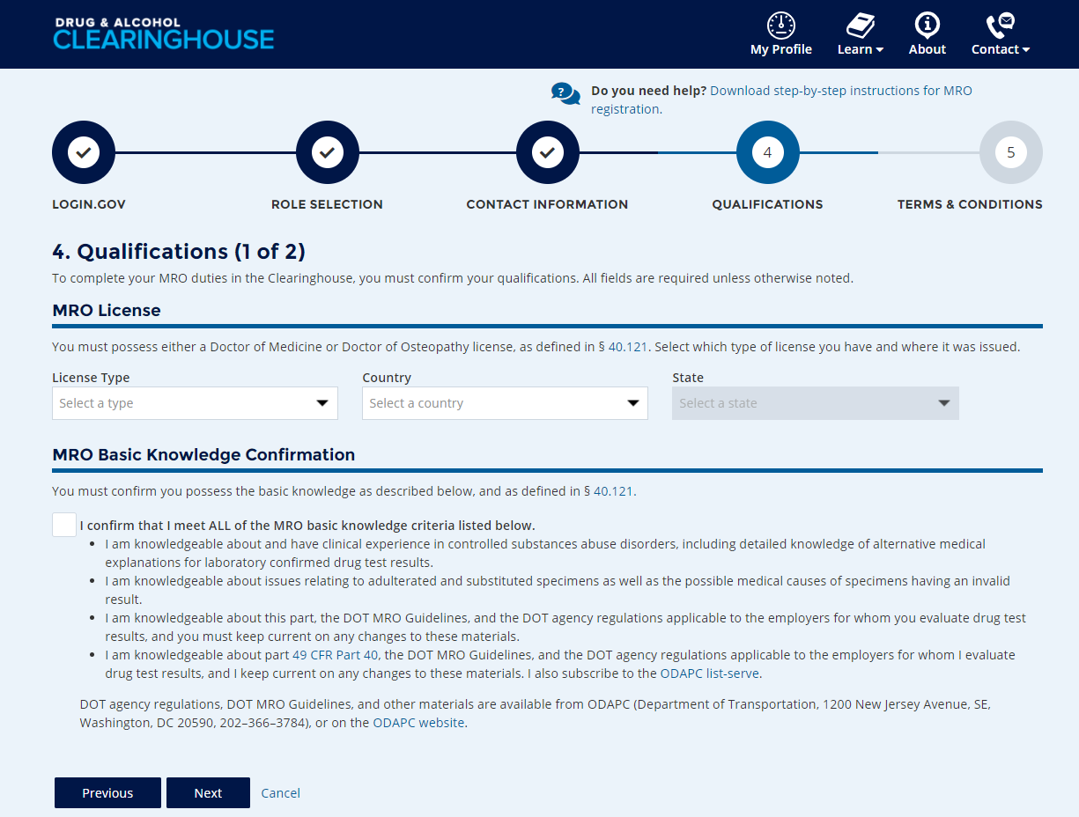
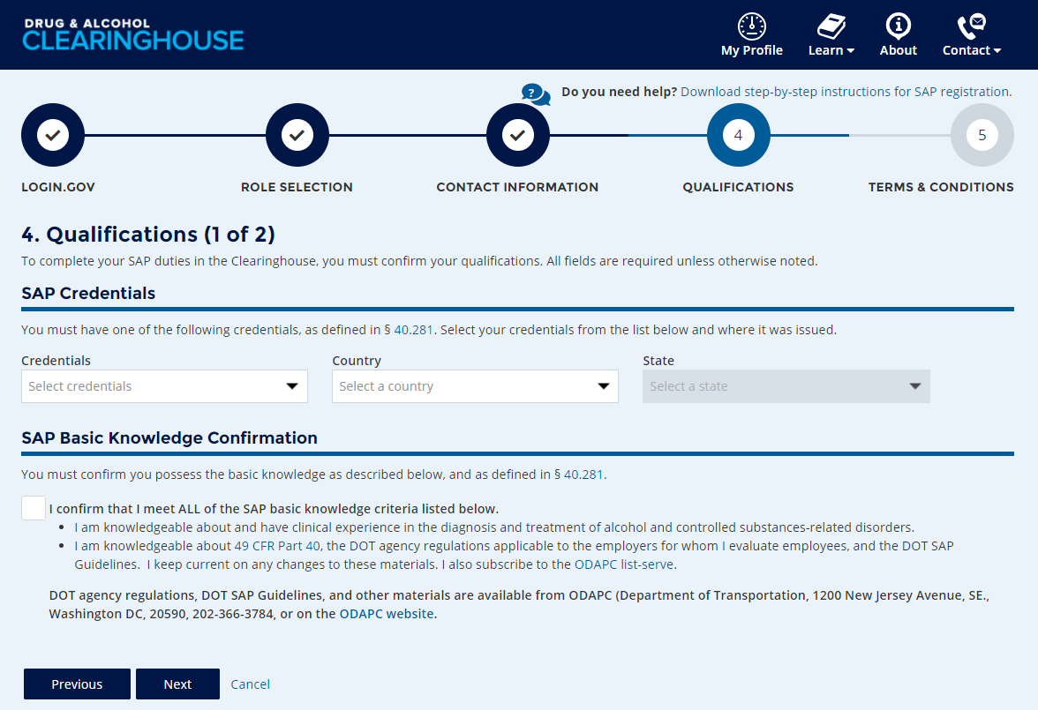
Registering for the Clearinghouse – MROs and SAPs
MROs: Enter your MRO license information and self-certify you meet all MRO qualifications, per § 40.121
SAPs: Enter your SAP credential information and self-certify you meet all SAP qualifications, per § 40.281
Notes:
If you will use the Clearinghouse on behalf of an MRO or SAP, they must send you an invitation to register as their Assistant.

Slide 23
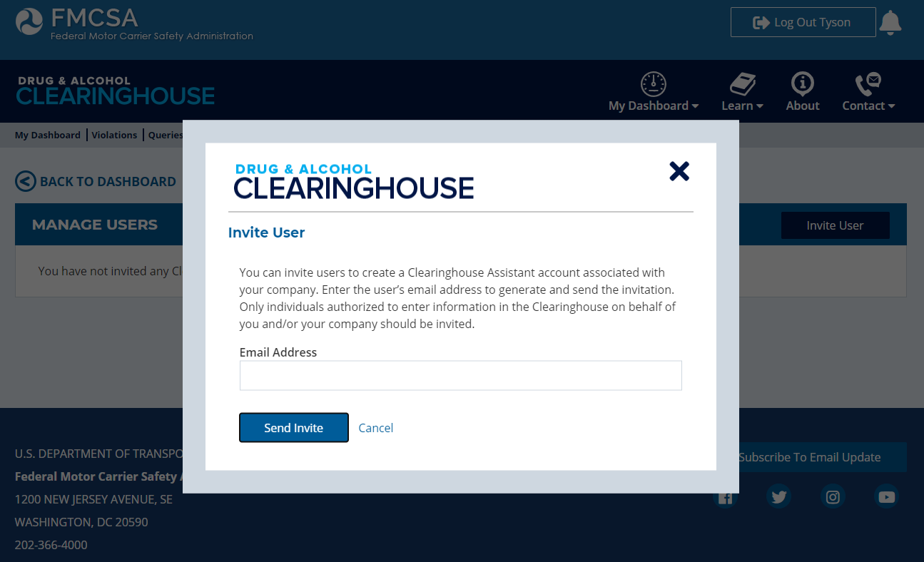
Inviting Other Users
Invite Assistant(s)
Ensure continuous access
Employers: not required for Portal users
Drivers do not have this feature
Additional Administrators register on the Clearinghouse website
Notes:
Once you have completed registration, you have the option to invite one or more Clearinghouse Assistants. Using this feature sends an email invitation to the Assistant. The Assistant must use the link in the email invitation to begin their Clearinghouse registration. This will link the Assistant’s Clearinghouse account to your organization.
Allowing multiple users to access the Clearinghouse on your organization’s behalf will ensure uninterrupted access to the Clearinghouse due to staff transitions, etc.
A note for Employers: Inviting an Assistant is not required if your company has a USDOT Number. Your users should go to the Clearinghouse website and register using their Portal User ID and password, which will allow the Clearinghouse to recognize the Clearinghouse User Role in each user’s Portal account.
If your organization will have more than one Administrator, all Administrators should go to the Clearinghouse website to begin the registration process.

Slide 24
Queries and Consent Requests
Notes:
Let’s now take a closer look at the requirements for conducting queries and obtaining driver consent.

Slide 25
Query Requirement
A query is a check of the Clearinghouse to ensure a CDL driver is not prohibited from performing safety-sensitive functions (such as operating a CMV) due to a drug and alcohol program violation
All queries require driver consent
Purpose | Description
Pre-employment query | Required for all newly hired CDL drivers - Until January 5, 2023, a manual check is still required for the prior 3 years
Annual query | Follows a rolling 12-month calendar Example: Query driver J. Smith on December 1, 2020 – not required to query J. Smith again until December 1, 2021 If you have not yet conducted annual queries, the deadline is January 5, 2021

Slide 26
Consent Requirements Based on Type of Query
Reason for Query | Type of Query | Consent Required
Annual query | Limited Query | General consent, done outside the Clearinghouse May be electronic or wet signature, one time or unlimited Limited consent form must specify time range
Pre-employment query | Full Query | Specific consent, provided electronically within the Clearinghouse Required for each full query of an individual driver
Download a sample general consent form.
If a driver refuses consent (for any query) the query cannot be conducted and the driver is prohibited from performing safety-sensitive functions for that employer.
Notes:
Given the type of query, here are the requirements for driver consent.
Note that if a driver refuses consent (for any query) the query cannot be conducted and the driver is prohibited from performing safety-sensitive functions for that employer.

Slide 27
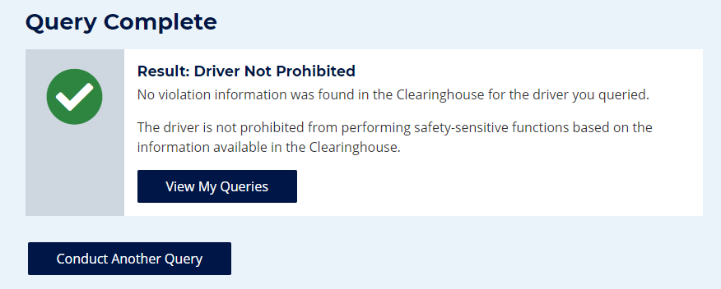
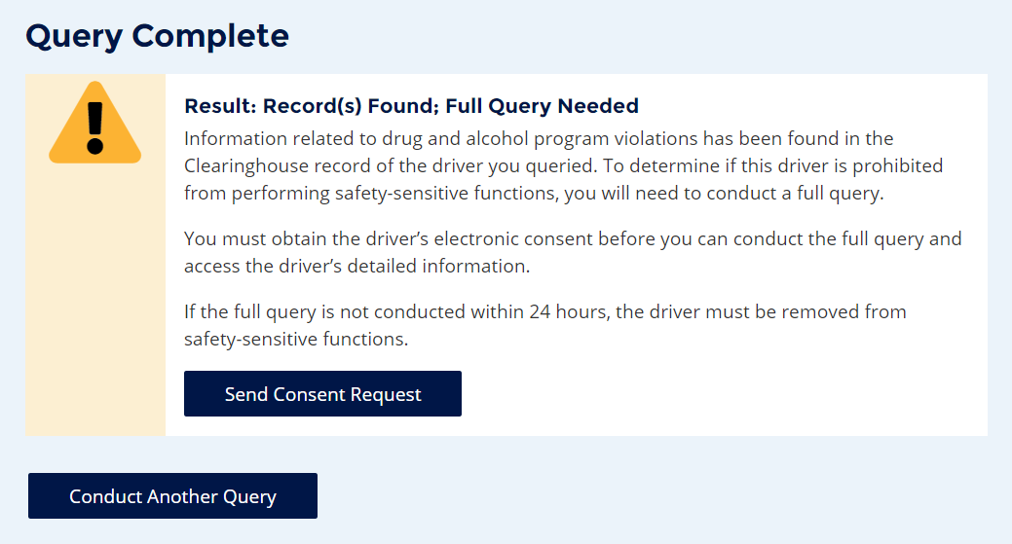
Query Results – Limited Query
“Record(s) Found” is not a notification that a queried driver is prohibited from performing safety-sensitive functions. The full query is needed to determine the driver’s eligibility status.
Notes:
Here are some sample query results for a limited query.
If a limited query determined that there is no violation information in the driver’s Clearinghouse record, the results will show “Driver Not Prohibited”
If information related to a drug and alcohol program violation is present in the driver’s Clearinghouse record, a notice appears stating “Full Query Needed”
Note that “Record(s) Found” is not a notification that a queried driver is prohibited from performing safety-sensitive functions. This could be information related to a closed RTD process, meaning the driver could be eligible to operate a CMV.
A full query is needed in this case to determine the driver’s eligibility status.
We’ll run through the results of a full query shortly.

Slide 28
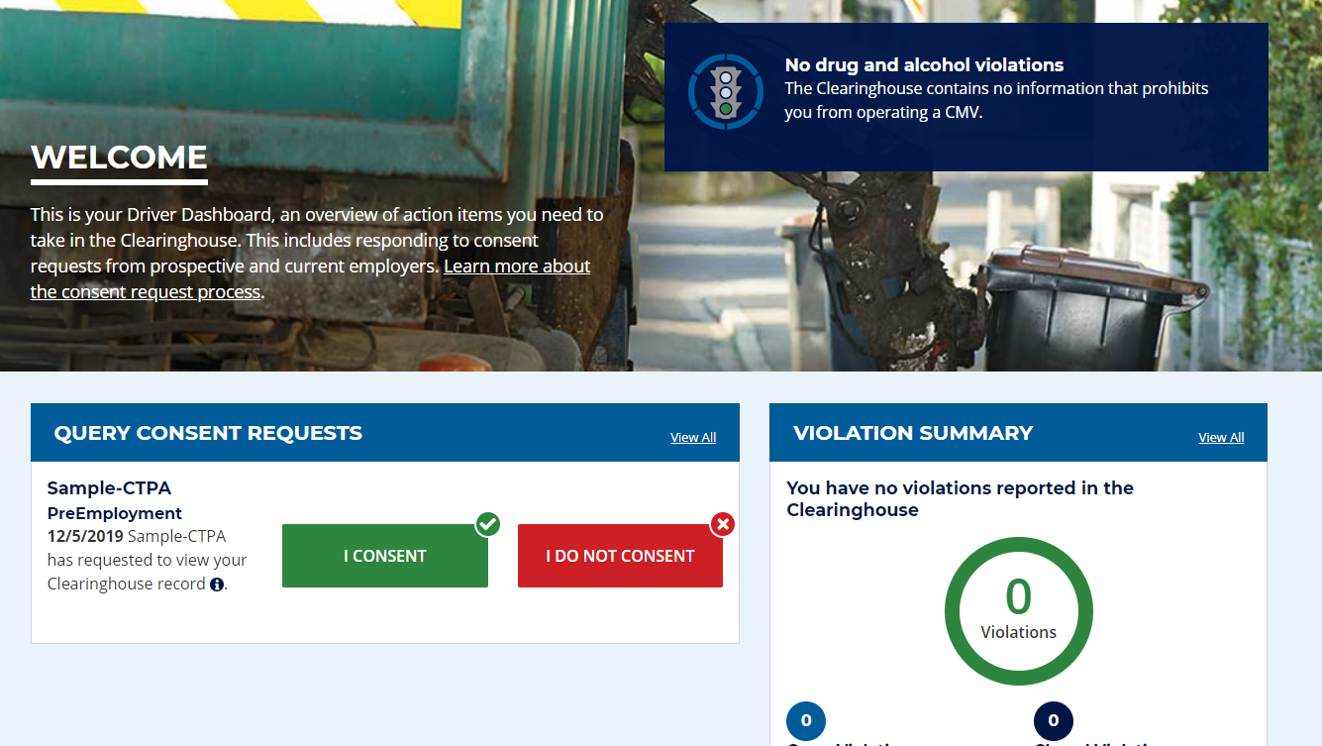
Drivers Responds to Consent Request in the Clearinghouse
Drivers will log in to the Clearinghouse to respond to a consent request
Query consent requests will be displayed on the Driver Dashboard
Notes:
If a full query is needed, a consent request will be sent to the driver. You can see an example of what that looks like in a driver’s Clearinghouse account on the screen. The driver will then respond to the query request.
Drivers must be registered in the Clearinghouse to provide consent for pre-employment and full queries.
Employers must obtain a driver’s consent before querying the driver’s violation information.
Again: Failure to provide consent to such a request will result in the driver being prohibited from performing safety-sensitive functions (including operating a CMV) for that employer, in accordance with 49 CFR 382.703(c).

Slide 29
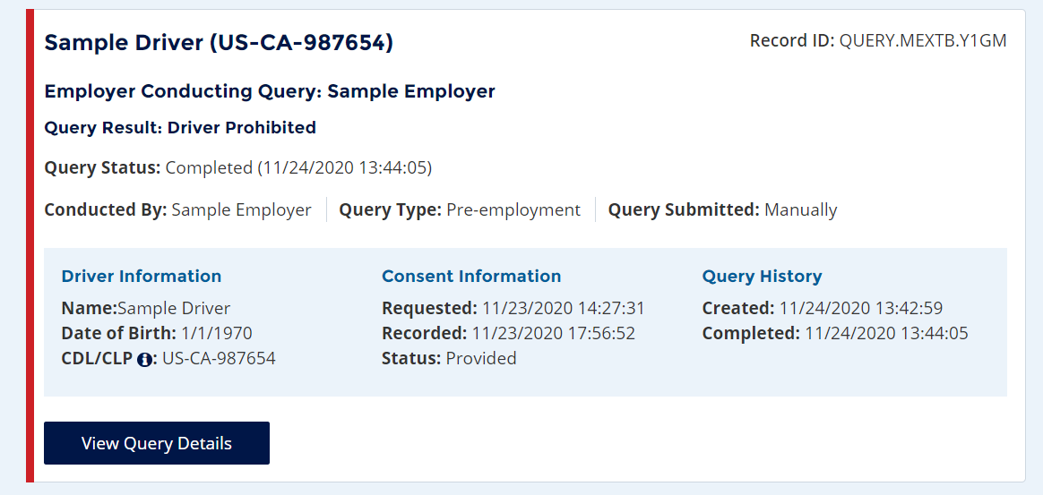
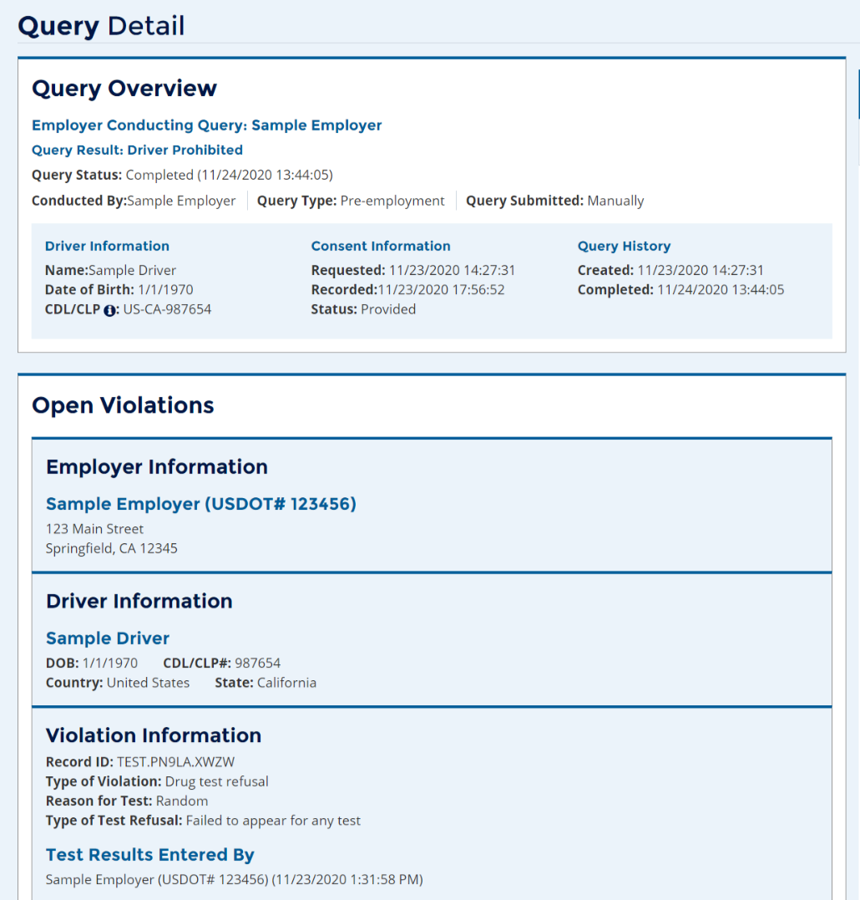
Employer Query Results – Full Query
Notes:
Now let’s discuss the results of a full query.
Once an employer receives a notification email that the driver has responded to the consent request, the employer will log into the Clearinghouse and view their Queries Conducted Page that provides an overview of each query.
Depending on their notification settings, the employer may also receive a notification within the Clearinghouse.
An employer can click on View Query Details to view the details of the query.
Drivers can also log in to view the details of the query and any other information in their own driver record. We’ll talk more about this shortly.
A pending query will display a yellow band until a driver has provided consent.
A red band, like the one you see on the screen, will be displayed if the query returns that the driver is prohibited from performing safety-sensitive functions at the time of the query.
After 24 hours of a limited result returning, if a driver has not provided consent it turns red.

Slide 30
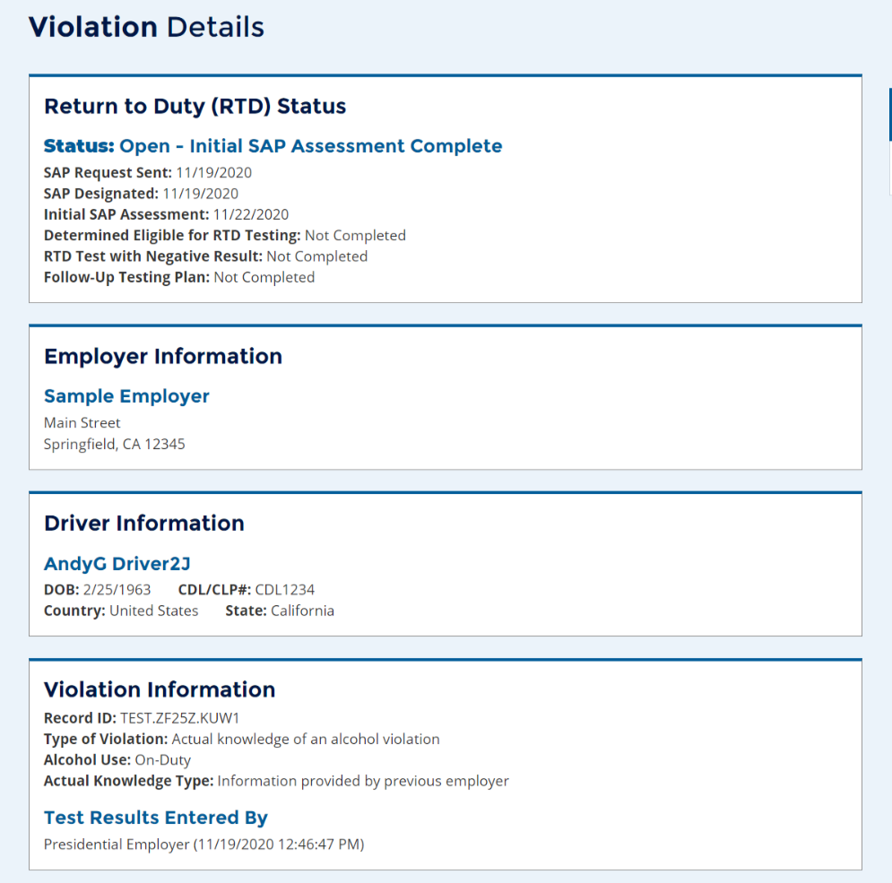
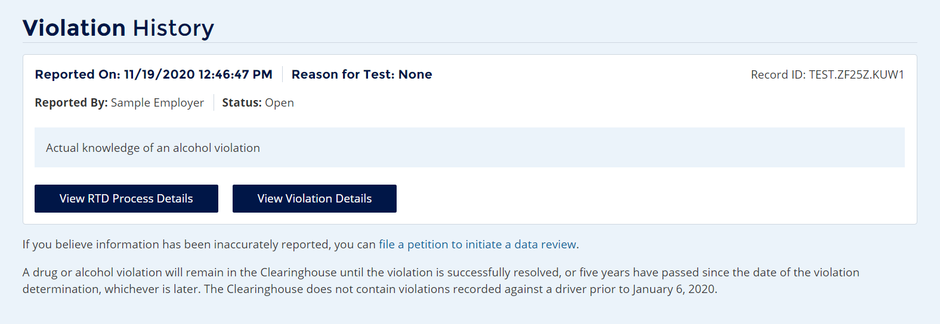
Driver’s View of Violation Information
Notes:
As we said earlier, registered drivers can always log into the Clearinghouse to review the information in their own driver record.
If you believe violation information has been inaccurately recorded, you can request a data review. We will go into more detail on that later in the webinar.
From your Violation History you can click View Violation Details to see the full information that will be shared with an employer who conducts a full query (with your consent).

Slide 31
Reporting Violations in the Clearinghouse
Notes:
Let’s take a closer look at reporting violation information in the Clearinghouse.

Slide 32
Reporting Violations – Employers and C/TPAs
What violations are the employer or designated C/TPA required to report?
REPORTING ENTITY | INFORMATION TO BE REPORTED TO CLEARINGHOUSE
Prospective/Current Employer of CDL Driver Or Service agent acting on behalf of Current Employer of CDL Driver | An alcohol confirmation test with a concentration of 0.04% or higher
 | Refusal to test (alcohol) as specified in 49 CFR 40.261
 | Refusal to test (drug) not requiring a determination by the MRO as specified in 49 CFR 40.191
 | Actual knowledge, as defined in 49 CFR 382.107, that a driver has used alcohol on duty, used alcohol within four hours of coming on duty, used alcohol prior to post-accident testing, or has used a controlled substance
 | Negative RTD test results (drug and alcohol testing, as applicable)
 | Completion of follow-up testing
Notes:
Here are the violations that employers, or their designated C/TPAs, are required to report in the Clearinghouse…[read slide]
Employer has 3 business days to report.

Slide 33
Actual Knowledge: What It Is, What It Isn’t
Actual knowledge must be based on one of the following:
Employer’s direct observation of an employee
Information provided by the driver’s previous employer(s)
A traffic citation for driving a CMV while under the influence of alcohol or controlled substances
An employee’s admission of alcohol or controlled substance use, except as provided in §383.21
A verified positive drug test result does not qualify as actual knowledge
When reporting actual knowledge, employers must upload supporting documentation. This may include:
Notification to report for testing (date, time, location)
Any emails between the employer and the driver
Documents of termination or resignation
Notes:
We wanted to make sure everyone understands what does and does not qualify as actual knowledge of a violation.
To be recorded in the Clearinghouse, actual knowledge must be based on one of the following… [ read slide ]
Note that employers should NOT report positive drug test results as actual knowledge, as this can lead to duplicate reporting. Positive drug test results are entered by the medical review officer.
When reporting actual knowledge, you will be prompted to upload supporting documentation. This may include… [ read slide ]

Slide 34
Reporting Violations – MROs and SAPs
What information is the MRO or SAP required to report?
 | INFORMATION TO BE REPORTED TO CLEARINGHOUSE | DEADLINE FOR REPORTING INFORMATION
MRO | Verified positive, adulterated, or substituted drug test result | Within two business days of making a determination or verification of a DOT-approved drug test
 | Refusal to test (drug) requiring a determination by the MRO as specified in 49 CFR 40.191
 | Changes a verified drug test per 49 CFR Part 40 | Within one business day of making any change in the reported results
SAP | Date the initial assessment was completed | By the close of the business day following the date of initial assessment
 | Date of determination of eligibility for RTD testing | By the close of the business day following the determination that the driver completed the RTD process
Notes:
You may be wondering about information MROs and SAPS will report in the Clearinghouse. This information is listed here [ read slide ]

Slide 35
Frequently Asked Questions
How long is the violation information retained in the Clearinghouse?
5 years or until the follow-up testing plan is successfully completed, whichever is later.
Can an MRO or employer report a drug and alcohol program violation if the driver is not registered for the Clearinghouse?
Yes. The Clearinghouse will associate the violation with a driver’s CDL information. This will be recorded even if the driver has not registered for the Clearinghouse.
Notes:
Before we move on, let’s look at some FAQs related to violation reporting.

Slide 36
Frequently Asked Questions
What information may be challenged by the driver?
The accuracy of the information reported
If the driver received a traffic citation for driving a CMV while under the influence of drugs or alcohol which did not result in a conviction, driver may petition to submit documentary evidence of non-conviction to be included in their Clearinghouse record
Accuracy of test results and refusals may not be challenged
How does a driver change or remove inaccurate data?
The driver may submit a petition via FMCSA’s DataQs system
FMCSA will review petition and notify driver of decision to remove, retain, or correct information in the Clearinghouse and the reason for decision
If the driver believes a petition decision was made in error, he/she may submit a request for an Administrative Review
Request must include an explanation why he/she believes FMCSA made an error in their decision
Driver informed of decision
Decision will constitute as the final Agency action
Notes:
To review, there are only 3 reasons that a Clearinghouse record can be amended under 382.717:
a data entry error (e.g., wrong name, wrong CDL number, wrong test result, etc.) has occurred;
a DUI citation which was the basis of an actual knowledge report did not result in a conviction; and
an employer reporting either a failure to appear refusal or actual knowledge violation did not comply with the respective reporting requirements (382.705(b)(3) & (4)).
Within 45 days of receiving a complete petition, FMCSA will inform the driver, in writing (email or letter), of its decision to retain, remove, or correct the information in the database and provide the basis for the decision.
Example of denied petitions: drivers were arguing they had not refused, based on their versions of the facts.
A driver must provide evidence (e.g., notice of suspension) to support the claim that information recorded in the driver’s Clearinghouse record is inaccurate. If the driver fails to provide sufficient evidence, his or her petition will be closed with no further action taken.
A driver may request an expedited review if the inaccuracy is currently preventing him or her from performing his or her job duties per § 382.717(e). FMCSA will respond to expedited reviews within 14 days. Note that the driver must provide evidence (e.g., notice of suspension) in order to request an expedited review.

Slide 37
Frequently Asked Questions
The return-to-duty (RTD) process has not changed
Driver must designate a DOT-qualified SAP after a positive or refusal
Date the driver’s initial SAP assessment is completed
Note: Employer must provide the driver with a list of potential SAPs
Designated SAP will enter information about the driver’s treatment into the Clearinghouse
Driver will need to take a negative RTD test, test results are recorded in the Clearinghouse by the employer or designated C/TPA
Will a driver’s follow-up testing plan be available in the Clearinghouse?
No, follow-up testing plans will not be included in a driver’s Clearinghouse record.
When a prospective employee has not completed a follow-up testing plan prescribed by the SAP, the subsequent new employer must obtain the follow-up testing plan from the previous employer, as required in § 382.413, and report the date the follow-up testing plan was completed.
Notes:
§ 40.287 What information is an employer required to provide concerning SAP services to an employee who has a DOT drug and alcohol regulation violation?
As an employer, you must provide to each employee (including an applicant or new employee) who violates a DOT drug and alcohol regulation a listing of SAPs readily available to the employee and acceptable to you, with names, addresses, and telephone numbers. You cannot charge the employee any fee for compiling or providing this list. You may provide this list yourself or through a C/TPA or other service agent.

Slide 38
Common Issues

Slide 39
Common Issues – Registration
Incorrect Role
Employer registered as a C/TPA
Cannot designate a C/TPA
Cannot purchase a query plan
Employer registered as an Assistant, not as an Admin
Cannot designate a C/TPA
Cannot invite Assistants
Employer registered as a Driver

Slide 40
Common Issues
Add or update CDL
Click the “Edit Profile” or “My Profile” from the dashboard
Click the link “Add Your CDL #” in the upper right-hand corner
Enter information without any spaces or dashes
Notes:
FL CLPs: Call the CDL helpdesk in FL and they can manually add the pointer and should correct the validation issues.
850-617-2000 – the driver will need to tell the Help Desk that they have a CLP and the Clearinghouse will not validate it and they need it corrected.

Slide 41
Common Issues
Multiple roles
Current Role drop down box to switch between roles
Add or Update C/TPA
Employer role must be set to DACH Motor Carrier Admin in Portal

Slide 42
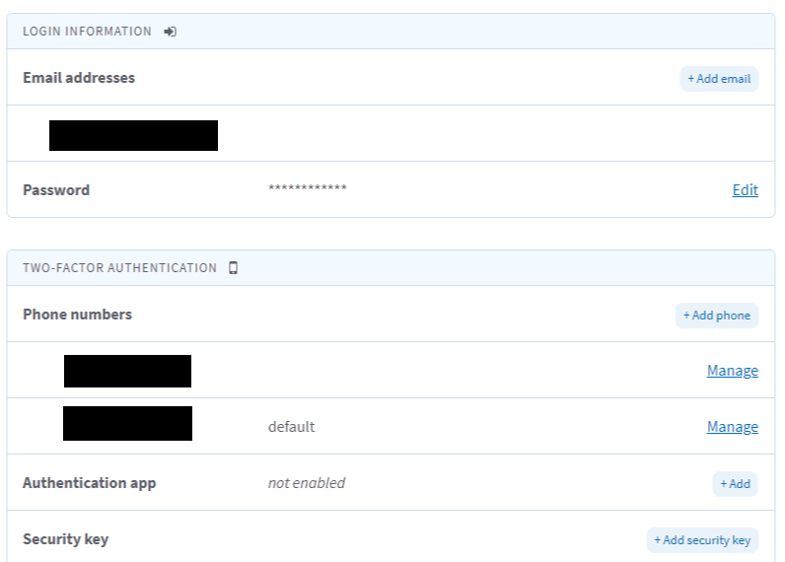
Common Issues – login.gov
Change email address and authentication method
Log in to https://secure.login.gov/.
Scroll to add or edit “Two-Factor Authentication.”
Click on “Add email”. Then, click on “Delete” next to the email address you are replacing.

Slide 43
Common Issues – Violations
Driver cannot view query or violation information
Verify MRO or Employer reported the violation
Verify correct CDL information was entered for the Driver
Verify registration included your CDL information
Driver cannot designate a SAP
Ensure violation was reported
Verify correct CDL information was entered for the Driver
Ensure the SAP is registered
Ensure the Driver is entering the SAP’s name correctly

Slide 44
Frequently Asked Questions
Notes:
Now let’s take a look at some common issues users have been experiencing in the Clearinghouse.

Slide 45
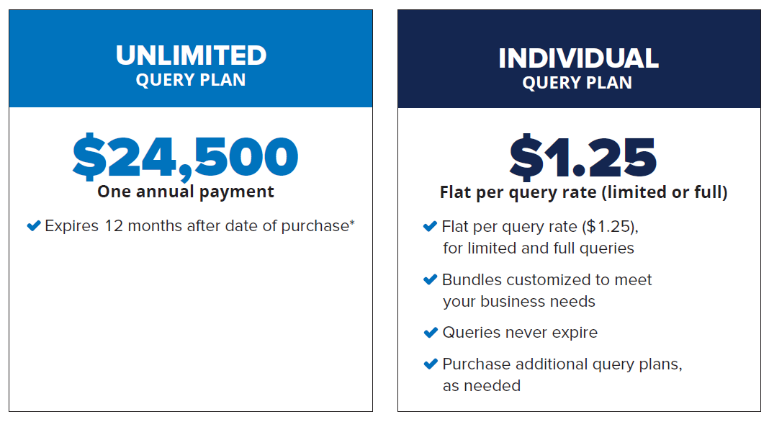
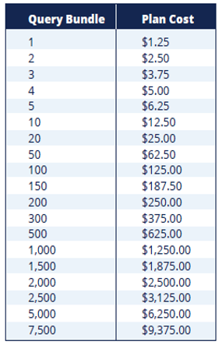
Frequently Asked Questions
Recommended for High-volume users

Slide 46
Frequently Asked Questions
Why purchase a query plan?
Employers are charged a fee for conducting queries in the Clearinghouse.
Employer must purchase a query plan to ensure they or their designated C/TPAs can conduct queries.
Can C/TPAs purchase a query plan?
No, only employers can purchase query plans.
How does the employer purchase a query plan?
Query plans may only be purchased from FMCSA on the Clearinghouse website. Download the How to Purchase a Query Plan job aid factsheet to learn more.
Which query plan is right for me?
Query bundles
Purchase the number of queries equal to the number of your current employees (satisfy your annual queries needs)
Purchase additional query plans, as needed
Unlimited query subscription
High volume users

Slide 47
Frequently Asked Questions
Will a prospective employee’s drug and alcohol violation history with other DOT modes be available in the Clearinghouse?
No, the Clearinghouse will contain only drug and alcohol program violation information for employees subject to the testing requirements under the Federal Motor Carrier Safety Regulations in 49 CFR part 382.
Will every driver need to register in the Clearinghouse?
No. A driver will only need to register if they need to provide consent to the employer in the Clearinghouse for pre-employment/full queries.
If a driver is currently with an employer, never incurs a drug or alcohol violation, and never seeks other employment, then the driver does not need to register in the Clearinghouse.
Can an employer register their drivers in the Clearinghouse?
No. Each individual driver will need to register himself or herself. Registration and login will require users to complete the verification process

Slide 48
Frequently Asked Questions
Are employers of non-CDL drivers who operate CMVs required to query or report violations to the Clearinghouse?
No. Only employers who employ drivers subject to Parts 382 and 383 must query or report information to the Clearinghouse.

Slide 49
Frequently Asked Questions
Will the employer be notified if a new violation is recorded on previously queried driver?
The employer will receive a notification if a new violation was recorded in the Clearinghouse for the queried driver within 30 days of conducting a pre-employment query (30-day look back).
The employer must receive additional electronic consent from the driver before a full query can be conducted to view detailed violation information.
Will the employer receive notification of new violations within 30 days of all completed queries?
The employer will not receive a notification of new violations after completing a limited (including annual) query or ad hoc full query.
The employer will receive a notification if a new violation was recorded in the Clearinghouse for the queried driver within 30 days of conducting a pre-employment query (30-day look back).
Notes:
30-Day look back (382.701(c))

Slide 50
Frequently Asked Questions
Are Canadian and Mexican drivers conducting operations in the United States subject to the Clearinghouse requirements?
Yes, only Canadian and Mexican drivers operating in the United States are required to comply with FMCSA drug and alcohol testing requirements and must comply with the Clearinghouse final rule.
Must Canadian and Mexican employers report drug and alcohol program violations to the Clearinghouse?
Yes, only Canadian and Mexican employers operating in the United States are required to comply with FMCSA drug and alcohol testing requirements and must report drug and alcohol violations to the Clearinghouse.

Slide 51
Frequently Asked Questions
Can an employer designate more than one C/TPA?
Yes.
Who will record positive alcohol results for an owner/operator?
The designated C/TPA would be responsible to record this violation information regarding the owner/operator they work with.
An owner/operator may view and query their own information.
An owner/operator will be required to self-identify as an owner/operator and will be required to designate a C/TPA to access their Clearinghouse account.

Slide 52
Frequently Asked Questions
Will a driver’s follow-up testing plan be available in the Clearinghouse?
No, follow-up testing plans will not be uploaded into the Clearinghouse.
When a prospective employee has not completed a follow-up testing plan prescribed by the SAP, the subsequent new employer must continue to obtain the follow-up testing plan from the previous employer, as required in §382.413, and complete the follow-up testing.
Will follow-up testing be tracked within the Clearinghouse?
No, follow-up testing will not be tracked in the Clearinghouse.
However, if there is a positive follow-up test result, it must be reported as a new violation.
The RTD process would be re-initiated after the new violation is entered.

Slide 53
Frequently Asked Questions
How does an employer or consortium/third-party administrator (C/TPA) submit a bulk query?
Download and complete the Bulk Upload Template File. (C/TPAs: If you work with multiple employers, you will need to upload a separate file for each employer.)
Once you have edited the template bulk upload file to include the appropriate driver information, log in to the Clearinghouse. Under My Dashboard, go to Queries and select Submit a Bulk Upload.
If a driver is on the road and unable to access a computer, how can the driver access the Clearinghouse?
The Clearinghouse is mobile-friendly. The driver will be able to access the Clearinghouse from a smart phone, log in and view their information as well as provide consent and identify their substance abuse professional, if applicable.
Notes:
30-Day look back (382.701(c))

Slide 54
Frequently Asked Questions
Is the driver’s social security number (SSN) or employee identification number (EIN) required when reporting violation information or querying the Clearinghouse?
No, per §382.123, the employer shall provide the driver’s CDL number and state of issuance
What information is required on the Custody and Control Form (CCF) or Alcohol Testing Form (ATF)?
The driver’s CDL number and state of issuance must be entered in lieu of the driver’s SSN or EIN
Will FAQs and other outreach materials about the Clearinghouse be updated?
Yes, our website at https://clearinghouse.fmcsa.dot.gov will be updated regularly with new information, including the factsheet and FAQs. In addition, you will be able to sign up for email updates.

Slide 55
Clearinghouse Rule II & CDL Downgrades
Notes:
Now that we’ve covered the initial Clearinghouse rule, what the Clearinghouse is, and who must use it, let’s take a look at the recent final rule that covers State Clearinghouse requirements for non-issuance and downgrading of CDLs.

Slide 56
The Clearinghouse Rule II
State Driver’s Licensing Agency Non-Issuance/Downgrade of Commercial Driver’s License
Published: October 7, 2021
Effective date: November 8, 2021
Implementation date: November 18, 2024

Slide 57
Major Rule Provisions
Non-issuance
Mandatory CLP and CDL downgrade
Application of the State query requirement to CLP holders
Addition of the CMV driving prohibition to Part 392
Actual knowledge violations based on issuance of a citation for DUI in a CMV
Compliance date
International impacts

Slide 58
Non-Issuance
SDLA must query the Clearinghouse prior to issuing, renewing, transferring, or upgrading a CDL or CLP
SDLA must deny a commercial license transaction (non-issuance) if the Clearinghouse query shows the driver is prohibited

Slide 59
Application of State Query Requirement to CLP Holders
CLP holders (commercial learner’s permit) are covered by the requirements of the rule
SDLAs must query the Clearinghouse prior to issuing, renewing or upgrading a CLP

Slide 60
Mandatory CDL Downgrade
SDLA will receive notification of a driver’s Clearinghouse status
SDLA to pull information from the Clearinghouse
FMCSA to push a notification to the SDLA
SDLA must initiate the process to remove a CLP or CDL privilege (downgrade) when notified of a driver’s Clearinghouse violation
FMCSA will notify the SDLA when a driver completes the RTD requirements and is no longer prohibited
If FMCSA removes a violation erroneously entered in the Clearinghouse, the SDLA will be notified
SDLA must reinstate commercial driving privilege
SDLA to expunge the driving record accordingly

Slide 61
Actual Knowledge Based on Issuance of a Citation
A CDL or CLP holder charged with a DUI in a CMV has violated part 382, subpart B, regardless of whether driver is convicted of the offense
Driver will be required to go through the return-to-duty (RTD) process
Violation will remain in the Clearinghouse for 5 years, or until the driver has completed RTD, whichever is later
Driver may submit documentary evidence of non-conviction to their Clearinghouse record

Slide 62
Compliance Date
States must achieve substantial compliance as soon as possible, but no later than November 18, 2024
Obtain legislative authority
Establish IT connectivity between State IT system and the Clearinghouse
Train all necessary staff in new procedures

Slide 63
International Impacts
No change to current requirements
Drug testing rules apply to Canadian and Mexican drivers who operate a CMV in commerce in the United States
Canadian and Mexican drivers who test positive or refuse a test are prohibited from operating in the United States and must complete the RTD process

Slide 64
Next Steps
Register
For information to get started, visit https://clearinghouse.fmcsa.dot.gov/Register
For more information:
Visit the Clearinghouse Learning Center at https://clearinghouse.fmcsa.dot.gov/Learn for resources and answers to common questions
Contact us:
Division Contact Name, Division Office
Division Office Phone Number
Contact Clearinghouse Team:
Email clearinghouse@dot.gov
Call 844-955-0207

